Slide 1
Flexwork products on USP
Outcome Solution Intent
Author(s):

Slide 2
Key Links
ST21486: BUILD FLEXWORK PRODUCTS ON USP AND MIGRATE FlexWork groups/members from UHOPS to USP
FlexWork Business Needs - All Items

Slide 3






Flexwork Overview
What is Flexwork ?
Flexwork is a product suite for Key Account/National Account employers with seasonal, part-time or variable workforces. It combines Level Funded medical coverage with financial protection products (fixed-indemnity)
Current High-Profile Clients
FlexWork Fast Facts:
Launched on UHOPS 1/1/22
Grown to 43 clients and 40K members
Expected to nearly double in next 5 years

Slide 4
Flexwork Definitions
# | Term | Definition | Revenue arrangement | Claims Administration platform
1 | Flexwork Medical (MEC/MVP) | A Level Funded Medical plan with limited benefits to workers with flexible work arrangements (Example: Seasonal Workers) using choice network. MEC – Minimum Essential Coverage medical along with ASL only stoploss MVP – Minimum Value plan medical along with ISL & ASL stoploss | LF | Flexwork Medical (MEC/MVP) – Cirrus Rx – Optum Rx *
2 | EHIPP + NET (standalone) | Enhanced Hospital Indemnity Protection Plan that takes advantage of the Choice Plus Network Contracted Rates. The plan pays out a fixed cash amount for medical and Rx services when specific criteria is met. The plan pays the fixed cash amount to the Provider first up to the contract allowed amount, any remainder benefit after paying provider would go to the member. | FI | Cirrus
3 | EHIPP (standalone) | Enhanced Hospital Indemnity Protection Plan. The member receives a fixed cash benefit when specific claim criteria is met. The fixed cash benefit is issued to the member via the OnBase platform | FI | Onbase
4 | Bridge Plan | A ‘package’ sold to a customer that includes either limited medical benefit (1) AND a EHIPP + NET (2) plan AND a traditional Accident Supplemental Health Financial protection Plan There are two flavors without wellness coverage: No benefit overlap between flexwork medical & EHIP+NET With wellness coverage: EHIP+NET wellness benefits that overlap with flexwork medical | Flexwork Medical – LF EHIP+NET - FI Accident Protection plan - FI | Flexwork Medical (MEC/MVP) – Cirrus Rx – Optum Rx* EHIP+NET -Cirrus Accident supplemental Health - Onbase
5 | Critical Illness (standalone) | Standalone Critical Illness is a supplemental health plan that pays a fixed lump-sum cash benefit when insured person is diagnosed with a covered serious illness such as cancer , heart attack or stroke. There are a couple of flexwork customers in UHOPS that are sold Critical illness | FI | Onbase
6 | Cash Collateral | Some Flexwork groups have an agreement with us where they pay a cash collateral to allow claims to continue to pay if they are past their paid through date. This Cash collateral typically covers 1 month of claims however it is not used for claim payment. | LF Cash collateral only applies to LF plan options | N/A
*Ancillary products – Standalone dental, Vision, Financial protection plan – Life, ADD etc. already offered
*Carve out PBM is out of scope for initial phase of Flexwork

Slide 5
Flexwork Overview – Key differences/impacts
Product & Benefit Administration
Support configuration and offering of the new type of flexworks plans - LF Flexwork medical and the new set of indemnity plans - EHIP+NET, EHIP, Accident and Critical illness
Customer implementation & install
Support systematic installation and cirrus group structure enhancements to offer the new flexwork plans alongside the standard LF medical and standalone ancillary plans already offered within USP under single member group
Billing/Payment/Commissions
Support new deferred payment processes including Collateral and grace period.
Support presentment of additional member identifier to invoice PDF and invoice reports.
Support different producers, rates and rate types across products
Finance
Support two entity reserve for a single group, one for ASL and one for ISL & ASL [Based on the PDD decision]
Support multiple adjudicated funding arrangements
Support ASL only stoploss offering
Claims Processing
Support adjudication of EHIP+NET in cirrus including fixed amount payout of medical and Rx services
Support EOB, PRA and portal unique representation of Adjudication results and accumulators
Support provider and member payout of EHIP+NET benefit

Slide 6
Impacted Product Capabilities for FlexWork on USP
UHC Product Capability Model
PRODUCT SUITES
PRODUCT CAPABILITIES
Provider Aligned Products
(Medical)
Medicare
Member Management
Customer Management
Provider Management
Product & Benefit Administration
Medicaid
Enrollment & Eligibility
Member Billing & Collections
Member Data & Preferences
Member Fulfillment
Member Interactions
Member Self-Service
Customer Installation
Customer Implementation
Customer Fulfillment
Billing & Receivable Management
Customer Interactions
Customer Self-Service
Provider Onboarding & Maintenance
Provider Search
Provider Interactions
Provider Self-Service
Product Offering
Product Filing
Benefit Data
Benefit Search
Benefit Content Management
Consumer
Engagement
Products
(Clinical, Rx,
Spending
Accts, etc)
Exchanges
Financial
Protection
Products
Claims Management
Operations
eCommerce
Consumer Engagement
Common Claim Capabilities
Claims Configuration
Claims Pre-Processing
Claims Adjudication
Claims Payment & Presentment
Outbound Medicaid/Medicare Encounters
Appeals & Grievances
Enterprise Communications
Omni Channel Service Experience
Operational Quality
Workforce Management
Learning Solutions
Shop
Checkout and Payment
Personalization / Identity
Product Catalog
Search and Content
Reporting
Asset Management
Consumer Data Management
Insights Management
Investment Management
Journey Management
Marketing Operations Management
Behavior Health Solutions
AllSavers
Level Funded
Network
Digital Therapeutics
Experience
Advocacy
Individual Health & Wellness
Student Resources
Utilization Management
Care Management
Financial Management
Value Based Reimbursement
Inpatient Mgmt & Concurrent Review
PCP to Specialist Referral
Prior Auth & Notification
Urgent/Emergent Care
Care & Disease Management
Care Coordination & Transition
Clinical Decision Support
Community Based Care
Digital Health-Nerve Center & Care Pathways
Financial Accounting & Reporting
Finance – Data Analytics
Financial Operations Management
Regulatory Operations State Reporting
Reimbursement & Stop Loss
Delegation/DOFR/DOMR
Capitation
Incentives & Penalties
TPA Services
Vision
Dental
Hearing
Pet Insurance
Sales
Marketing
Data, Analytics & Reporting
Development impacts
Configuration & Test Only
Intermittent Workforce
Migration
Engage Agents
Sell to Customers
Set Sales Strategy
Underwriting
Marketing Campaigns
Marketing Education
Data Exchange (External & Internal)
Operational & Analytical Reporting
Pricing, Analytics & UW (PAU)

Slide 7
Sales & underwriting

Slide 8
Sales/Underwriting – Key considerations
FlexWork sales on USP will leverage Solaris & MERIT for key and National accounts with implementation on OBM. Merit to OBM automation is not in scope.
FlexWork underwriting will continue to use the current tools for manual rating of FlexWork products. Building FlexWork underwriting capability into Newton 2 will be a separate future scope
FlexWork underwriting quotes use nonstandard plan exhibits. These will be manually keyed in during implementation. Digitization of these exhibits are not part of the current scope
For the initial new business scope, FlexWork products are offered to Level Funded funded Key and national account market on USP. Offering Flexwork to ASO & FI will be part of separate future effort.

Slide 9
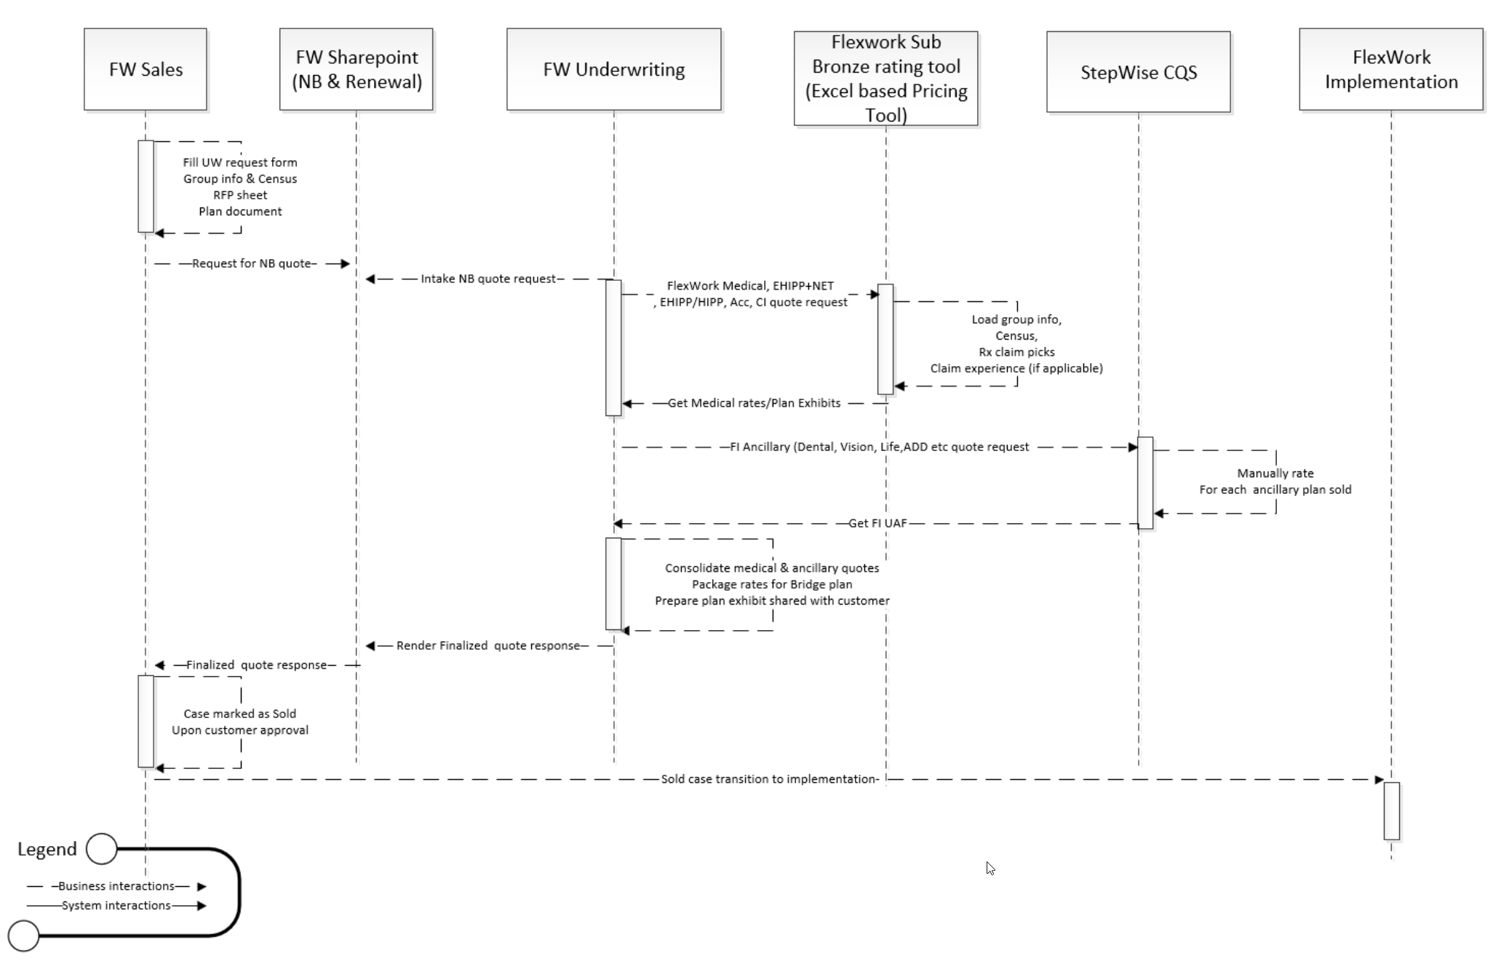
FlexWork Sales & Underwriting – Current state
FlexWork uses SharePoint to intake and manage new business and renewal quote request
FlexWork underwriting team (separate team than the Level funded or ancillary underwriting team) uses excel based pricing tool to underwrite FlexWork products
UW of Specialty Products (dental, vision, financial protection) is performed by Flexwork UW team leveraging Stepwise CQS (not involving Specialty UW) manually.
FlexWork underwriting follows manual step to consolidate and present the quote back to the customer
Flexwork UW process is tracked within Sharepoint and communicated to Sales via e-mails

Slide 10
FlexWork Sales & Underwriting - Future state
FlexWork Sales and underwriting process will continue to leverage the manual process for FlexWork enablement on USP
LF FW Medical, EHIPP+NET, EHIPP/HIPP, Critical illness and accident is rated using manual excel based rating tool
Quotes for FlexWork ancillary (Dental, Vision) and Financial protection are manually underwritten in Stepwise CQS
Underwriting manually transfers the rate information and consolidate rates to present on customer sales exhibits
Any variation/Carve out of Clinical programs (MedCents, EAP) will be identified during sales and passed down to Underwriting and implementation
Life and STD will be implemented on FACETS manually while all other products are being implemented on USP. This is for both new and migrating business.

Slide 11
Sales & Underwriting - Impacts
Impact Item / Requirement | Impacts / Dependencies
Ability to leverage MERIT application by FlexWork Sales for National Accounts | FlexWork Sales team in current state uses both MERIT and the FlexWork SharePoint to manage the Sales intake and the communication with FlexWork Underwriting for quoting - FlexWork Sales/Underwriting Operational process impacts, SOP/Workflow updates – Will be part of the operation readiness conversation MERIT already has the definition of all the FlexWork product types. No integration between MERIT and Cirrus Light weight API for Member group id generation. MERIT does not track the cirrus member group id. Once the group is market as sold, Member group id generation will be don’t manually in cirrus – Operational impact No integration between MERIT and OBM. Sold case transition to implement will happen manually – Operational impact No IT impact identified on MERIT.
Ability to leverage Solaris application by FlexWork Sales for Key Accounts | FlexWork Sales team in current state uses both Solaris and the FlexWork SharePoint to manage the Sales intake and the communication with FlexWork Underwriting for quoting - FlexWork Sales/Underwriting Operational process impacts, SOP/Workflow updates – Will be part of the operation readiness conversation Solaris already has the FlexWork ‘product type’ definition but updates may be needed to make the productTypes available for USP platform – Config & IT impact Solaris has integration with Cirrus Light Weight to generate cirrus member group id – No impact Solaris can systematically trigger Sold case transition to OBM. No impact
Ability to identify customers sold through FlexWork sales to tag them to FlexWork specific market segment during implementation | OBM will need to derive FlexWork specific market segments when a customer is sold FlexWork plans identified by the FlexWork Specific product types – Operational and IT impact FlexWork Key Account – Solaris may have some impact to route the case to OBM and the right IMO team FlexWork National Account
Plan availability/exclusion rules | Operational, will be enforced by the FW Sales team
Support the customization of FlexWork plans – FW medical, EHIPP+NET/EHIPP/HIPP & Bridge plan | Refer custom plan sequence diagram IT impact

Slide 12
Clinical Programs

Slide 13
Clinical Programs Offered with Flexwork
There are 7 medical plan options offered for Flexwork: Basic MEC, Basic Bridge, Standard MEC, Enhanced MEC, Standard Bridge, Enhanced Bridge, and Edge MVP.
Each medical plan has a pre-defined package of clinical programs attached.
PT/OT/ST Network and Chiro/CAM Network are packaged with the medical plan as a benefit and attached network and do not need separate utilization plans. The combination of which programs are packaged with which medical plan is pre-defined. Each of these pre-packaged offerings may be Opt-Out by the customer (e.g. it’s pre-packaged but not mandatory).
Collection of Rewards programs are offered as buy-up to any of the medical plan options. Clinical wants to see these programs reflected as part of the BOSS POP ID and these programs also require a separate utilization plan (w/o BOSS POP ID).
Solution Approach: setup each plan option with customer specific arrangements (CSA) – no shared arrangements involved. (see solution options analysis for more details).
Flexwork Clinical Program Analysis.xlsx – Solution Options Analysis

Slide 14
Clinical Going In Position
Based on variability of the clinical program election for Flexwork across the various plans, Option #2 was chosen to be the solution pattern for managing clinical offerings for Flexwork:
  Option #2: setup each plan option with CSA (customer specific arrangements) - no SSA involved
  -- since CSA are initiated by BOSS, enhance BOSS to auto-add embedded programs (e.g. PT/OT/ST and Chiro/CAM) based on the medical plan offering
  -- exclude any Opt-Out choices of embedded programs from customer
  -- add any buy-up programs
  -- BOSS > PL: request PHM UP
  -- PL detect programs that require separate UPs (e.g. UHC REWARDS) and add those onto the list of UPs for OBM
  -- OBM attaches the PHM UPs and non-PHM UPs onto contract option
We need to determine the # of BOSS POP IDs needed for each contract based on the # of Flexwork plans offered and the corresponding # of regular LF medical products offered.
  Coordination between USP Implementation and Clinical Implementation: Determine # of BOSS POP IDs needed.
    Re-use Clinical Pattern from Surest ASO: OBM > (2.1.1.3) SalesSync360 > (2.1.1.4) SFGO > (3.1 & 3.2) BOSS
Flexwork Clinical Program Analysis.xlsx

Slide 15
Clinical Program - Impacts
Buy-Up Program Pattern: Solaris/Merit > SalesSync360 (non-Optum) > BOSS > Plan Library > OBM > BBMA
Embedded program configuration and Opt-Out Pattern: BOSS > Plan Library > OBM > BBMA
Impact Item / Requirement | Impacts / Dependencies
Buy-Up Program | Solaris / Merit: source of buy-up program(s) sold SalesSync360: aggregate buy-up program(s) sold from Solaris / Merit and pass to SFGO (Optum), BOSS (non-Optum), and Plan Library (Both) SFGO: collect customer opt-out decision for any BOSS:
Trigger of BOSS POP IDs | OBM: send Flexwork plans and # of BOSS POP IDs to SalesSync360; note: standard LF plan offerings have SSAs

Slide 16
Clinical Implementation on USP (proposed)
Post slides 17 & 18 to chat
Current Sourcing of PIM Products (slide 10)
Aggregate Sold Case into SalesSync360
  2.1.1.7 PIM > SalesSync360
  2.1.1.1 Solaris > SalesSync360 > SFGO
  2.1.1.2 Merit > SalesSync360 > SFGO
  2.1.1.3 OBM > SalesSync360
3) Pass Sold Programs to Implementation
  2.1.1.5 SalesSync360 > BOSS (non-Optum)
  3.1 & 3.2 SFGO > CAAS > BOSS
  2.1.1.6 SalesSync360 > Plan Library
Coordinate BOSS POP ID & Utilization Plan
  4.1 BOSS > PL
  4.2 PL > BOSS
Build Utilization Plan in Cirrus Product Core
  5.1 PL > Cirrus Product Core
Assign Utilization Plan to Group Structure
  6.1 OBM < PL
  6.2 OBM < Cirrus Product Core (still need?)
  6.3 OBM > BOSS
  6.4 OBM > Cirrus MG (HW & CCV3 API)
Recent Changes:
6.4 OBM > Cirrus MG (HW & CCV3 API)
  New attributes for UPs of embedded components that are opt-out (e.g. BH programs).
2.1.1.7 PIM > SalesSync360
  New BOSS attribute
2.1.1.6 SalesSync360 > Plan Library
  Leverage 6.1 PL > OBM for all programs (BOSS & non-BOSS)
2.1.1.5 SalesSync360 > BOSS (non-Optum)
  3.4 BOSS consumption of non-Optum programs
Sample BOSS programs:
    Complex Medical Conditions (CMC) – Bariatric, Cancer, Transplant, CAD, CHD, Fertility, etc.
    Consumer Rewards / Discount Programs – Surest Rewards: Core, Premium, Custom, etc.
Source: Clinical Programs on USP.vsdx
Back to ToC

Slide 17
Product & Benefit Administration

Slide 18
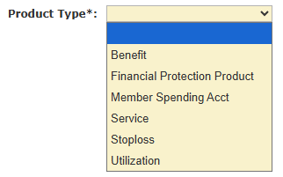
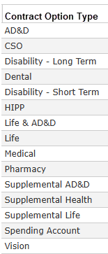
C262550: FlexWork: EHIPP +NET Product
Plan library needs to get data feed from Stepwise CQS
Stepwise will not get data feed from Newton 2
  UW [currently Jennifer Travers] needs to use Stepwise for pre-built custom plan data for it to get to PL
New product
  Fully insured
  Product type: New product type to differentiate the EHIPP +NET from other FPP
    No impact on PL for creating a new product type
  Plan type: 03 Indemnity
  Benefit_type: New benefit type
  Should try to keep it 1:1 with a contractOptionType

Slide 19
C262550: FlexWork: EHIPP +NET

Slide 20
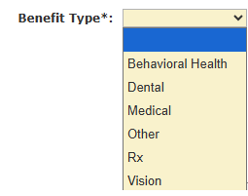
C262550: FlexWork: EHIPP +NET Plan
Plan setup
  New benefit type
  Network schedule
    Choice (new)
  Two benefit tiers
    INN
    OON
  New service component tied to EHIPP +NET benefits
  Benefit code setup
    Rx benefit code?
    No cost share
    New attributes at BCTLV level
      Payout Amount
      Direct pay member only
  COB schedule attached to plan
    Use COB Method of No Coord of Benefit.
  Guardrails
    Don’t impose medical state mandates
    Need to only enforce ones specific to indemnity
      i.e. Maternity waiting period
    Need to explore the regulatory/policy flow
  OON Pricing schedule will need to be attached to plan
    Determination of if a new schedule or enhancements are required will be discussed during the pricing solutioning discussion.
  DOFR Config
    No DOFR set assigned
    No Delegation set assigned
    No behavioral/physical health delegation on this plan.
  Tabs that we don’t need
    Copay
    Coinsurance
  Attribute Schedule
    Any key attributes?

Slide 21
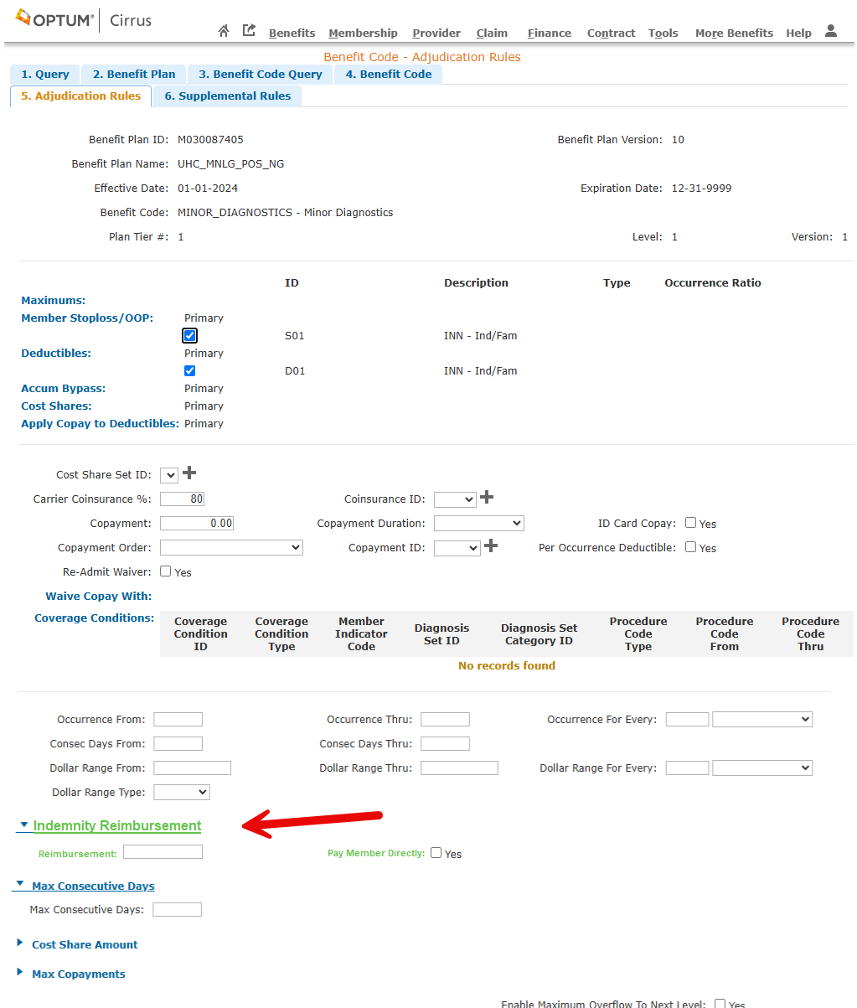
C262550: FlexWork: EHIPP +NET BCTLV Screen
CBB Impact
New attributes an BCTLV level on beneCodeAdj screen
      Reimbursement {dollar}
      Pay member directly {Boolean}
Exact location on UI to be determined by delivery team

Slide 22
C262550: FlexWork: EHIPP +NET Product

Slide 23
C262550: FlexWork: EHIPP +NET Plan – Exception
States that do not allow using network discounts
    CA is the only state with this requirement where we have a customer today.
    Other States: FL, AR, VA, SC, TN, CT, KY, GA, TX, NJ, CO, NC, IN, MA, NY, UT, PA, AZ, MI, WA
    Use a network schedule that has no networks within it
      Validation issues with an empty network schedule – Val to check
      Need to investigate what this option breaks throughout the plan build/validation.
      This also requires that we only have an out of network tier (no in network tier).
      Help ensure network logos don’t get added to ID card

Slide 24
C262550: FlexWork: EHIPP +NET Bundle
Migration discussion on grandfathered well baby coverage
  EHIPP +NET
Need a new bundle benefit type for at least the stand alone EHIPP +NET bundle
Need to source and store EHIPP +NET data from Stepwise
  Possible schema changes
    Lissette to provide schema for EHIPP +NET
    Pull in comprehensive supplemental health package.
      EHIPP +NET
  New collection?
    Assume yes for purposes of this capability solution.
Need to allow for some type of template management to support plan automation (the +NET)
  Use source data from Stepwise - different than medical collection used today
  Plus allow for configuration/automation to set needed Cirrus level plan details
    Benefit Type
    Product
    Netschedule + tiering (INN/OON)
    Serv Comp
    Benefit Code setup – New breaking changes on BCLTV (40pts – schema, plan generation/publish service, plan streaming pub/consumer)
Need to understand if there are any impacts to BenSums/SBCs (SBC 2.0?) re: EHIP+Net
  No – Plan Library will not generate.
    Generation of documents will be estimated outside of this capability
    Method of obtaining documents will be handled in appropriate other capabilities based on their requirements.
      Need to document the process in the sales/underwriting capability for how they will obtain for their purposes.
We will assume that the EHIPP +NET plan build process will align with the same process as the medical automatic plan build process being implemented.
We need an attribute from Stepwise CQS that explicitly identifies the EHIPP +NET plans
EHIPP +NET will be its own bundle/bundle option
  When sold as a bridge plan, the EHIPP +NET bundle will be attached as a subcontract option to the medical contract option

Slide 25
C262550: FlexWork: EHIPP +NET Accum
Annual visit limits
Rx accum
Surgery/anesthesia
  Inpatient/outpatient has its own limits
  Anesthesia limits tied to surgery
    Use leveling of place of service to differentiate?
      Or could be two different benefit codes instead of leveling.
      IP
        21, 25, 26, 31, 32, 33, 51, 52, 54, 55, 56 & 61.
      OP
        5,6,7,8,9, 19, 22, 24,53, 57, 58, 62, 65, 99
    Do we have to tie anesthesia to a surgery?
      No
    Max days 2/2 IP/OP
    Benefit: 25% of applicable surgery benefit
      It is okay to configure the $ amount so long as it is kept updated if surgery payout is modified.

Slide 26
C255322: FlexWork: Ancillary Product Offerings (Excluding EHIPP +NET)
Cirrus Components
FPP
  No product/plan build in Cirrus
Dental
  Use existing products in Cirrus
    FI products only
    No embedded plans
Vision
  Use existing products in Cirrus
    FI product only
    No embedded
Plan library needs to get data feed from Stepwise CQS
  Dental/Vision
    Already automated from Stepwise CQS to Plan Library
  We do not do customization on any of these specialty products today

Slide 27
C255322: FlexWork: Ancillary Product Offerings (Excluding EHIPP +NET)

Slide 28
C255322: FlexWork: Ancillary Product Offerings (Excluding EHIPP +NET) FPP
Need to source and store supplemental data from Stepwise CQS into Plan Library
  Possible schema changes
    Pull in comprehensive supplemental health package.
      CIPP
      APP
      HIPP
      EHIPP
  Each type will be separate collections except HIPP, EHIPP and, EHIPP +NET
Need to understand if there are any impacts to BenSums/SBCs (SBC 2.0?)
  No – Plan Library will not generate.
    Generation of documents will NOT be estimated within this capability
    Method of obtaining documents will be handled in appropriate other capabilities based on their requirements.
      Need to document the process in the sales/underwriting capability for how they will obtain for their purposes.
Assumption: We will use the existing API process to build the contract option
  Need to confirm with the group install process.

Slide 29
C247972: FlexWork: Medical and Value Add Plan Library
Components
Assumption that medical plans will be built and managed within Portfolio Editor from FlexWork Catalog
  Building medical plans using LF standard as a national plan.
Customizations will be built and managed within Portfolio Editor

Slide 30
C247972: FlexWork: Medical and Value Add Product
Components
Funding source: Self-Insured / ASO
Plan Type: EPO
Product Type: Benefit
Use existing Open Access Level funded product ID

Slide 31
C247972: FlexWork: Medical and Value Add

Slide 32
C247972: FlexWork: Medical and Value Add Plan
Components
Funding source: Self-Insured / ASO
Revenue Arrangement: Level funded
Benefit Type: Medical
Network schedule: {new} Flexwork
OON pricing schedule to follow standard level funded plans
Attribute Schedule
  We will add a new attribute to specify plans that should be classified as “limited benefits”
Create newborn copay waiver
  Setup the copay waiver the same way we do on USP today based on an age-restricted level.
Maternity configuration for waiting period
  First period enrollment date within a benefit period
  As of date of service of admission.
  Assume minor enhancements to the waiting period logic on the BCTLV to calculate between these two dates.
  Assume a benefit code specific to childbirth only

Slide 33
C247972: FlexWork: Medical and Value Add Accum
Max $ benefit/admission
  Assume member responsibility after meeting regardless of MOOP
  Enhanced logic to the accumulator maximum screen to include either a new event or duration type of “admission” like how it was done on the copay max screen.
  Creation of new event type [admission] on benefit max screen
Max visits existing functionality – cross apply accumulators between benefit codes where necessary.
No enhancements needed to allow multiple minor/major diagnostic tests in a single day – plan pays for all tests so long as the DoS is the same day.

Slide 34
C247972: FlexWork: Medical and Value Add Accum
MEC Basic Standalone

Slide 35
C247972: FlexWork: Medical and Value Add Accum
MEC Basic Bridge

Slide 36
C247972: FlexWork: Medical and Value Add Accum
MEC Standard Standalone

Slide 37
C247972: FlexWork: Medical and Value Add Accum
MEC Standard Bridge

Slide 38
C247972: FlexWork: Medical and Value Add Accum
MVP Standalone

Slide 39
C247979: FlexWork: Maternity and Newborn
Maternity – EHIPP +NET only
  Waiting period specific to member enrollment, not subscriber.
  Need to cover member so long as enrollment remains within the same customer, even if the SL forces the member into a different member group.
  Maternity configuration for waiting period – only for Childbirth (admission and confinement impact only)
    First period enrollment date within a benefit period
    Complication of pregnancy is not contingent on the waiting period (is a covered benefit outside of this provision).
      A list of qualifying diagnoses is available.
    As of date of service of admission, not date of birth.
      Admission tied to delivery/childbirth
    Assume a standard waiting period would be assigned.
      If member doesn’t qualify based on standard waiting period, the claim should be dropped for manual review to check for eligibility exceptions
    Assume a benefit code specific to childbirth only
  Need Claims to start using the BCTLV waiting period
    Need to discuss the other waiting period types on how to handle if claims doesn’t do dev work for handling those waiting periods.
  Need a migration strategy for the first 9 months and previous enrollments.
    Audit rule to verify denied coverage – ensure member wasn’t previously enrolled on UHOPS.

Slide 40
C247979: FlexWork: Maternity and Newborn
Newborn
  Medical
    Create newborn copay waiver
      Setup the copay waiver the same way we do on USP today based on an age-restricted level.
    Use existing level funded configurations – no differences for FlexWork coverage.
    Verify process for handling when the mother isn’t on the plan, but the father is.
      Follow standard LF process.
      Do we deny newborn for other insurance verification for mother? No, no verification, and we would NOT apply the copay for days 1-4.
  EHIPP +NET
    Full EHIPP +NET benefits begins as of the dependent child event
      Excluding routine nursing or routine well baby (REV 170)
      REV codes to be provided for sick-baby provision
    Follow standard enrollment processes for newborn (MQ004 edit triggered)
      Newborn should be added for 31 days if parent is enrolled in a FlexWork plan
        Notation on benefit plan attribute schedule
      Coverage ends on day 32 unless enrolled as a dependent.

Slide 42
Product
EHIP, Critical Illness & Accident protection
  EHIP, Critical Illness and Accident protection plans will follow the same approach as the existing financial protection plan with adjudication in Onbase. Enhancement will be needed across the apps (Stepwise CQS, Plan library, Cirrus, Nimbus, Onbase ?) to make these plans follow the current pattern for FPP to support member group implementation and administration
EHIP + NET
  Follows the plan definition similar to cirrus adjudicated plans – Carrier, line of business, product, plan settings etc. No cost share information instead will have fixed cash payout benefit definitions – New service components, validation enhancements etc.
  More conversation to follow on claims business needs review
Flexwork Medical – MEC/MVP
  Follows the pattern similar to any other medical benefit plan/bundle option implementation in USP

Slide 43
Benefit Plan (Level 1) System of Record and Source of Truth
C237551: Business Capabilities: Phased Plan Activation Enablement | Rally
SIPOC | Custom Plan Design for Fully-Insured Medical
Supplier(s) | Customer via Sales Team Product Team
Input(s) | Product Team: Standard plan Customer via Sales Team: Prior incumbent plan or RFP
Process(es) | Portfolio Editor (SoR system of record for Level 1 Benefit Plan Definitions) Current state processes are defined in C228647, C228644, C231111 Support Benefit Modifications Outcome Solution Intent.pptx IMO/BCM begins the custom plan build by “copying” from the nearest pre-existing plan (can be standard or otherwise). IMO/BCM will follow existing processes for building the custom plan from DBS or Portfolio Editor. IMO/BCM will generate the benefit summaries and share with the customer to validate the custom plan definition. IMO/BCM will flag the plan as “Final” when they receive the approval from the customer. Portfolio Editor would publish the plan detail into Plan Library (SoT) when the plan status is set to “Final”.
Output(s) | Pre-sale Benefit Summary Documents “Final” plan reflected in Plan Library (SoT)
Consumer(s) | Cirrus Product Core Benefit Config Team
Note: “Final” status in Plan Library indicates that there’s sufficient information to support “Install Only” events and not necessarily claim readiness events. Claim readiness events would be supported when Cirrus Plan Status (benPlanStatus) = “A” (“Active”). The reference code for benPlanStatus of “Install Only” will be defined at the feature level.
Notes:
Assumptions:
- SPIs variations will fit into our existing plan benefit configuration patterns. If feature level analysis of SPIs identify exceptions, delivery team will escalate for EA/PA evaluation.

Slide 44
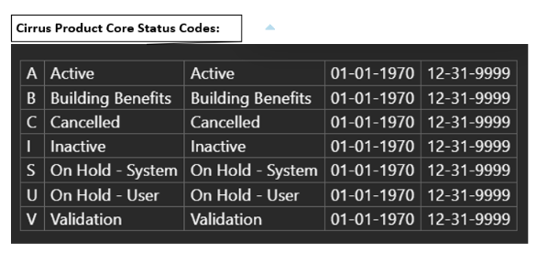
Benefit Plan (Level 1) Build Plan into Cirrus Product Core
C237551: Business Capabilities: Phased Plan Activation Enablement | Rally
SIPOC | Autonomous Plan Build (& CBB) from Plan Library (SoT) into Cirrus Product Core
Supplier(s) | Customer Implementation Team
Input(s) | IMO/BCM: A fully defined custom fully-insured medical plan (e.g. status = “Final”)
Process(es) | Autonomous Plan Build (trigger and track plan build process from CBB to Cirrus Product Core). APB monitors “Final” plan events from Plan Library (NRT). APB triggers and tracks the CBB processes (CBB-TE -> CBB-INT -> Cirrus Product Core) to build the plan into Cirrus Product Core. CBB-TE -> CBB-INT CBB leverages configuration templates to convert plan definitions from Plan Library into Service Components within Cirrus Product Core. CBB receives success or failure response from Cirrus Product Core with an additional “Install Only” status. CBB would trigger a configuration case within Configuration Desktop Tool (CDT) when the status is not “Active”. Configuration Desktop Tool (CDT) CDT team will take corrective actions to complete the plan build into Cirrus Product Core to transition the status from “Install Only” to “Active” Cirrus Product Core (CPC) CPC create a new status “Install Only” to depict the state in which there’s known benefit categories but missing service components. Waiting on details from James Weber
Output(s) | Successful autonomous plan build into Cirrus Product Core (status= “Active”) Failed autonomous plan build into Cirrus Product Core (status= “Install Only”) which would create a case within Configuration Desktop Tool (CDT) for Benefit Config Team to resolve.
Consumer(s) | Cirrus Product Core and Benefit Configuration Team Customer Implementation & Installation (OBM, Cirrus MG) Customer – Fulfillment (Cirrus Fulfillment – Magneto, COM360) Claims Management (Cirrus Claims) Downstream consumers of group activations: Clinical, Behavioral, Specialty Benefits, Incentive, Banking Services, etc.
Notes:
Assumptions:
- SPIs variations will fit into our existing plan benefit configuration patterns. If feature level analysis of SPIs identify exceptions, delivery team will escalate for EA/PA evaluation.

Slide 45
Member group approach for FlexWork
Requirement:
Certain FlexWork (FW) customers may require separate stop-loss policies and entity reserves when their plan selection includes a mix of:
  ASL + ISL stop-loss AND
  ASL only stop-loss
  Scenarios where this occurs: Customer elects
  FW MEC plan (ASL only) AND FW MVP plan (ASL + ISL) with or without Standard Level Funded Medical and ancillary plans
  Standard Level Funded plan (ASL+ISL) AND FW MEC Plan (ASL only) with or without ancillary plans
  Surest ASO medical AND FW medical or Fully insured Medical AND FW Medical (future mixed funding scenarios)
Issue: In order to support multiple entity reserves under one USP member group, there are significant impacts to downstream applications – Finance, Claims & billing
Current State (UHOPS):
  4 out of the 43 FlexWork customers (~10%) on UHOPS fall under scenario 1 or 2. These are currently supported by Managing customer under two member groups on UHOPS
    Array Corporation, Adecco Group, Pritchard Industries LLC, St. Moritz Security Services.
USP Approach:
  For 90% of the customer who do not fall under this scenario the decision is to support them using standard USP model of single member group
  For the 10% scenarios that require separate entity reserve, the recommendation is to use the tactical approach (option 1A – two member groups) based on current business needs and volume considerations
NOTE: As customers go through Sold Renewal changes, there is a possibility of transitioning from a single member group (USP standard) to a two-group structure under Option 1A when their product mix requires separate entity reserves or Vice-Versa. This transition will introduce a change in customer and member experience (e.g., interaction across multiple groups).However, this experience will remain consistent with current UHOPS operations, where customers manage offerings across multiple independent groups today.
Refer deck for more details on the program decision - FlexWork on USP - Member Group approach

Slide 46
Member group approach for FlexWork
Option 1: Single Member group
Option 1A: Two Stand-alone Member groups
For those customer with plan selection that includes mix of ISL+ASL stop-loss AND ASL only stoploss hence two entity reserve, option 1A will be leveraged. Based on current volume ~10% of the sold groups fall in this case
For rest of the customers that do not fall in this category a single member group will be used to manage all products/plans sold to the customer

Slide 47
FlexWork product on USP – Existing vs New
Product | ProductType | BenefitType / contractOptType | Financial Protection Plan Type | Source for installation | Requires bundle match & Assembly | Standalone or Offered with Medical
*Existing: FlexWork products that follow existing pattern on USP
FlexWork Medical (MEC/MVP) Level Funded | Benefit | Medical | N/A | Cirrus-Product | Yes | N/A
Dental Fully Insured | Benefit | Dental | N/A | Cirrus-Product | Yes | Standalone
Vision Fully Insured | Benefit | Vision | N/A | Cirrus-Product | Yes | Standalone
New: FlexWork products that are new to USP
EHIPP+NET Fully Insured | New - TBD | EN – Enhanced Hospital Indemnity Plus Network | N/A | Cirrus-Product | Yes | Both
EHIPP/HIPP Fully insured | Financial Protection | SE – Supplemental Hospital Indemnity | New | Plan Library | No | Standalone
Accident Protection Fully Insured | Financial Protection | SD – Supplemental Accident | New - TBD | Plan Library | No | Both
Critical Illness Full Insured | Financial Protection | SC – Supplemental Critical Illness | NEW - TBD | Plan Library | No | Standalone
*Table only shows products that are part of the FlexWork Master catalogue. FlexWork groups on USP can be sold other existing products that are offered to LF USP groups like Life, ADD, STD etc
Unlike other indemnity plans, EHIPP+NET claims will be adjudicated cirrus. Hence will follow a different pattern than the rest of the indemnity plans
The rest of the indemnity plans (excluding EHIPP+NET) will follow the existing financial protection plan approach for implementation and install with claims administered in Onbase
FlexWork Master catalogue - Source
*TBD items will be defined on feature F1895091

Slide 48
What is subContract option – Member group structure
A sub‑contract option allows an ancillary plan like Supplemental health or financial protection plans (e.g., Life, ADD) to be linked to and sold alongside a primary plan (e.g Medical), while still being managed as separate plans with separate rates.
How it is setup (benefit ally)
Both Primary Medical and the supplement health (benefit ally) are setup as separate contract options.
The subContractOption indicator on the supplemental health is turned ON to indicate it is a sub
One or more sub-contract option is associated to a Primary medical plan option.
With this setup, though both Medical and Benefit ally are independently configured and rated, can be offered as a package
This enables the sub contract plan options to be sold independently or together with primary as a package
Downstream behavior
When configured as mandatory, Members enrolled into the primary plan options are auto enrolled to the associated one or more sub-contract plan option
Enables a single enrollment experience across primary and sub
The sub contract plan options inherit the population, eligibility/insuring rules etc from the primary plan option

Slide 49
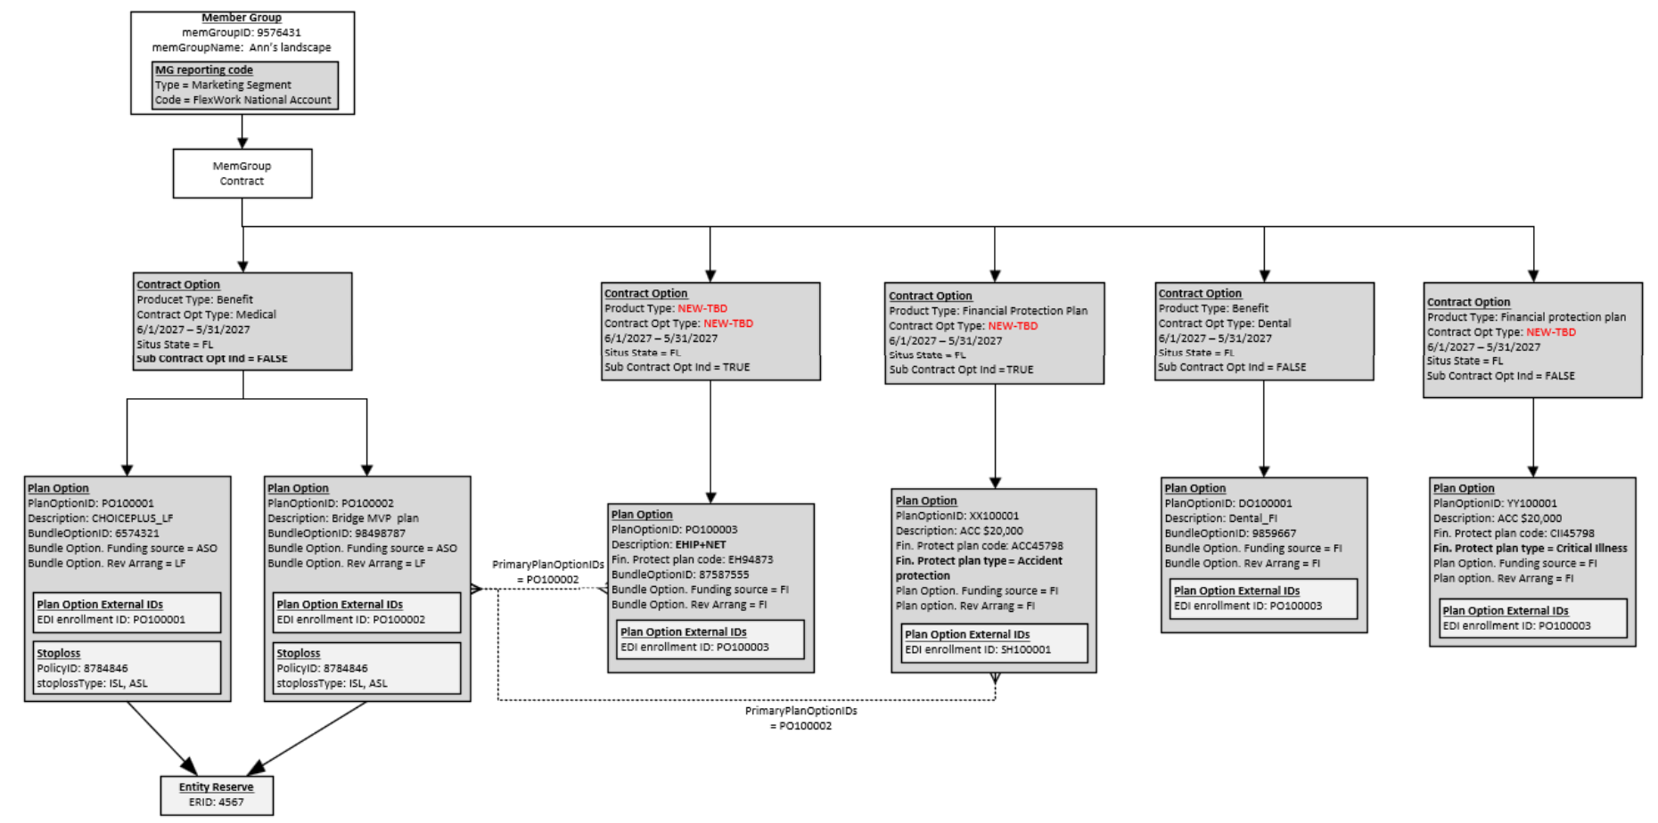
Member Group Contract – FlexWork illustration
Illustration shows a single member group contract with Standard LF Medical, FlexWork LF Bridge Medical plan, Standalone Dental and Standalone Critical Illness Financial protection plan
The Bridge plan is setup with a Primary Medical plan option and two sub-contract Option one for EHIPP+NET and the other sub-contract option for Accident protection
The EHIPP+NET plan option will be a separate bundle option with FI EHIP+NET base plan
The Critical Illness financial protection plan will be a separate standalone contract option with the plan option assigned to the Financial protection plan code configured on Plan Library

Slide 50
Customer Installation – Cirrus Member Group - C255316
Impact item / Requirement | Approach / Dependencies
Enhance cirrus member group contract UI and business logic to support new Flexwork product/plans with productType and ContractOptType | Reference updates to contractOptType & Financial protection plan Type to support the new Flexwork plans Enhance Cirrus member group contract option and plan option business logic to support the FlexWork plans No impacts identified for LF FlexWork Medical, Dental and Vision EHIPP+NET can be offered standlone contract option or as a subcontract option with Flexwork Medical plan option as primary. The other Flexwork Ancillary plans – EHIPP/HIPP, Critical Illness and Accident protection will follow the current FPP approach with plan build on plan Library. Impact to Plan library API called by cirrus to support these additional new product/plans Enhancement will leverage existing attributes, No new attributes needed on the member group contract UI/model Enhancement to contract option validation process to support new product & contract OptType Enhancement to sold plans feed from Cirrus to Basics (Valkyrie) Member group edit to disallow a member group from activation with more than one entity reserve configuration Impacted Teams: Cirrus-Member Group, Plan Library (API integration), Cirrus-product (Valkyrie)
Cirrus Member group API impacts (CISL) | Automation of FlexWork plans/products via HW and CCV3. Updates to GET APIs to support new Flexwork plans/products
Collateral Months (number of months) & Collateral amount when a customer has Collateral | Add new external id types at the plan option external id level to support manual entry of the paid through period in days or months and collateral amount when a group elects Collateral. New reference codes and associated validation will need to be considered No automation, will be managed by business operations with ability to carry forward the data on renewals The management of collateral months and collateral amount will be handled within the entity reserve associated to the member group. This will be covered in Collateral and grace period capability. No impact under C255316
New option to allow presentment of the member’s full SSN on the group invoice | Add new dropdown value to the “Invoice member id attribute reference code” on the bill group detail invoice setting. The existing option “Social security number” allows masked SSN presentment. New value must support full SSN
New market segment | - Finance requires any group with FlexWork offering to be identified with FlexWork specific market segment. Even if the group has non FlexWork plans along with FlexWork the whole group will be tagged with FlexWork Market Segment. Below are the new market segment values to be added FlexWork National Account FlexWork Key Account

Slide 51
Customer Installation – Cirrus Member Group - C255316
Impact Item / Requirement | Approach / Dependencies
Custom attributes | Support custom attribute and EPS derivation setup for FlexWork product/plan with all population types as applicable Test only with potential reference value (contractOptType) updates if needed
Member group contract/action events | Ability to trigger plan change/move, term, reinstatement and cancel utilities for new productType and contractOptTypes
Member group action events for fulfillments | - New member group exception codes – Reference data - Member Group action event impacts for separate triggers - ASA, SPD, Stoploss - follow Surest ASO approach Action events for New productType & contractOptType based on standalone vs sub CO Impacts will be covered under Customer fulfillment capability - C247974
Ability to link customers installed with multiple member group id (Option 1A) | Leverage member group external id Introduce new external id type in cirrus “Linked Member group id” to identify the other cirrus membergroupids a customer is managed under for the two-member group approach Allow for multiple “Linked member group id” for member group as long as the values are unique This will be manually managed via the IMO/case install ops process
Producer/commissions | Will be covered under capability C263345
Fulfillment impacts | Will be covered under capability C247974
Member Group impacts due to Billing | Will be covered under capability C255318

Slide 52
Enrollment/insuring rule - C255316
Impact Item / Requirement | Approach / Dependencies
Waiting period –Customer enforced | FlexWork customers apply waiting period calculation on their side and report the actual coverage effective date for enrollment. Expectation is for Cirrus enrollmen engine to honor the requested effective date as the actual coverage effective date in the system Cirrus already supports similar customers needing requested effective date to be actual coverage effective date by having the Member group insuring rule set to 0 day waiting period (date of event). No Dev impacts, test only Flexwork SPD document do not specify the waiting period days enforced by the plan sponsor/customer. Hence no additional impacts identified.
Termination date (rule) – customer supplied | Customer sends explicit term date on file that identifies the coverage end date. No additional grace period provided. Hence Term date will follow “date of event” on cirrus. No dev impact, test only
Retro Add, Change & term. FlexWork customers are offered standard 60 days retro and can chose unlimited | USP current state: All LF medical gets a standard 30 day retro limit via Enrollment Rule Schedule (ERS) Impact: Enhancement need to not apply the standard 30 day ERS for FlexWok Medical. Dependency: The ability to systematically override the retro rules via OBM will be handled under Surest ASO effort
Notification rule | Does not apply. Enforced by the customer/sponsor. No ERS schedule will be attached Impact: Enhancement need to not apply the standard 30 day ERS for FlexWok Medical.
Max Age – Customer can choose a low age limit than the guardrail/state limit | Current state: Cirrus member group has hard validation to not allow customer (contract option/population insuring rule) to go below the guardrail schedule. Impact: Relax validation to allow contract option/population insuring rule to go below the guardrail schedule. Example: State of FL guardrail has 30 years, Customer can choose 26 years age limit – applies to all max age fields – standard, Military & student max age
New-Born auto enrollment days | No impact, follow current SOP driven process
Eligibility service area validation | For medical benefits subscribers in Hawaii are excluded from coverage. EHIPP plan groups with situs in New Mexico are not eligible, however members living in New Mexico are eligible as long as the group situs is outside of New Mexico and the group size is less than 100. No impact, Follow current approach where the service area is validated based on members address state (Work address, followed by residence address). UHOPS migrated members will be excluded from the Service area validation. This exclusion will apply for Life.
Financial protection plans – Life, ADD, STD & LTD will follow the current enrollment/insuring rules coded on USP. No changes expected
Supporting any non ACA waiting period for Medical or ancillary will not FlexWork effort. This item is tied to surest ASO effort
A single member group with both Flexwork Medical and non FlexWork medical could potentially have different enrollment rules

Slide 53
Customer implementation – OBM - C255316
Impact item / Requirement | Approach / Dependencies
Implementation of FlexWork ancillary plan EHIPP+NET standalone (cirrus adjudicated) | Identify EHIP+NET as new productType & contractOptType within OBM, Follows manual see & key on OBM, no digitization EHIPP+NET will follow the bundle match and assembly logic Similar to standalone Dental or Vision. Dependent on Valkyrie/cirrus product for the bundle match and assembly for bundle option with FI EHIPP+NET plan No change anticipated on the HW/CCV3 request structure
Implementation of FlexWork ancillary plans EHIPP/HIPP, Accident protection and Critical Illness (adjudicated in onBase) | Identify EHIPP/HIPP, Accident protection and critical illness with new contractOptType within OBM, Follows manual see & key on OBM, no digitization PlanLibrary plan code will serve as the plan identifier, These plans will not go through bundle match and assembly similar to the current FPP implementation No new attributes expected on the HW/CCV3
Implementation of FlexWork Bridge plan with combination of primary and subContractOptions | FlexWork Medical will be identified as primary plan option with EHIPP+NET and Accident protection as independent subContractOptTypes. Refer to member group contract illustration diagram in prior slide The Medical and EHIPP+NET will go through bundle match and assembly while the Accident protection will follow the FPP approach
Implementation of other plans that are already offered in USP – LF medical, Standalone Dental, Vision and Financial protection plan – Life, ADD, STD, LTD etc | FlexWork customers will follow current approach. No change/impact identified to existing technology Ancillary quotes are not digitized. No integration between OBM and Plan library
Identify customers that have sold products requiring two entity reserve and implement them under two independent member group ids (Option 1A) | These customers will still have one underwriting & sales exhibits for all products. Customer demographics will be defined once in OBM but installed under two different member groups in cirrus vis two independent HW calls. Same approach will be followed for renewal under renewal capability. Leverage member group external id for any processes that need to tie the groups together. Assumption: Given the low volume ~10% this will follow manual approach. Operation impact to create the second member group on cirrus Oprtional impact to Support passing external id type CBC id when these customers support consolidation of invoice across both groups Member group must be loaded with the new external id type “Linked member group id” that points to the other member groups the customer has in cirrus
Custom attributes | Support custom attribute and EPS derivation setup for FlexWork customers with all population types as applicable - Operational impact EPS load API – new reference codes for contract opt types and regression testing

Slide 54
Customer implementation – OBM - C255316
Impact item / Requirement | Approach / Dependencies
Bill item type | FW LF Medical with Stoploss will use the existing bill item type for Admin Fee, Claim Fund, Stoploss ISL (if applicable), Stoploss ASL FI Ancillary will have premium. - No IT impact identified For standard LF Medical, OBM applies a standard 8.25% network access & outlier cost fee. This will not apply to Flexwork since it is part of the Admin fee – IT impact on OBM to not apply this for Flexwork plan options This item is dependent on the financial tagging capability C247971 As part of Billing management capability there is a new bill item Type need identified to support Collateral.
Market Segment | FlexWork customers will be assigned New FlexWork specific Market segment. This has to be supplied by Solari and MERIT to OBM IT impact
Entity Reserve | With option 1A, the entity reserve will stay 1 to 1 with the member group – no IT impact Ability to supply new surplus share percentage options for FlexWork customers on the entity reserve - IT impact Options include 2/3 , 50% & 100%
Customer specific plan names | Ability to define the plan option description – No IT impact
Stoploss setup | Stoploss related impact will be covered under C262928
OBM artifacts - Member group structure document, EPS attribute derivation sched, trial structure etc | Ensure the structure and EPS artifacts pulled out of OBM is updated to include the FlexWork product/plan and any derivation rules associated to the new contractOptType as needed
Assumption:
OBM can already send overrides for Max Age and has no additional impact to support max age lower than the Max age defined on the cirrus Guardrail. Cirrus member group will have enhancement to support contract option insuring rule to have a lower value than guardrail
The capability for OBM to send override retro rules will be handled under surest ASO

Slide 55
Link customers with multiple member group
New original source system type of “Linked member group id” will be used in cirrus to identify other instances of member group the customer may have
It will be a manual Ops process to track the scenarios (new business, renewal) needing multiple member groups. The Ids need to be added to all instances of that customer/member group in cirrus.
  Add the “linked member group id” manually as part of the manual set during the second member group creation
Downstream B&E and customer service portal (ACET BEO) will leverage the new external id to provide the toggle function

Slide 56
Market segment scenarios
# | Scenario | Expected outcome
1 | New business LF customer sold both Standard UHIC LF medical and FlexWork MEC/Bridge LF medical with or without Ancillary plans | Customer will be installed under two member groups. Both member groups will have the FlexWork specific Key Account (KA) or National Account (NA) market segment
2 | New Business LF customer sold both Surest LF medical and FlexWork MEC/Bridge LF medical with or without ancillary plans | Customer will be installed under two member groups. Would both member group have the FlexWork specific KA or NA market segment
3 | New Business customer sold both Surest ASO medical and FlexWork LF medical with or without ancillary plans | Customer will be installed under two member groups. Market segment for member group with FlexWork plan options will have FW specific KA/NA. But the Market segment setup will be based on who sold the Surest ASO. If it is sold by FW sales team then it will follow FW market segment if not it will not. Typically Surest ASO is not something available for FW sales team to sell
4 | Migrating Customer from UHOPs already existing in Cirrus with Standard UHIC LF medical with or without ancillary. Same customer in UHOPS migrating with FlexWork MEC/Bridge LF medical. There is no known migrating customer falling in this scenario as of 10/30/2026 | Existing customer is setup in cirrus with standard KA or NA market segment, no impact to this setup. Migrating UHOPS customer will be installed as a separate member group with FlexWork KA or NA market segment.
5 | Migrating Customer from UHOPs already existing in Cirrus with Surest LF medical with or without ancillary. Same customer in UHOPS migrating with Flexwork MEC/Bridge LF medical. There is no known migrating customer falling in this scenario as of 10/30/2026 | Existing customer is setup in cirrus with standard KA or NA market segment, no impact to this setup. Migrating UHOPS customer will be installed as a separate member group with FlexWork KA or NA market segment.
6 | Migrating Customer from UHOPs already existing in Cirrus with Surest ASO medical with or without ancillary. Same customer in UHOPS migrating with Flexwork LF medical. We have two groups falling in this scenario as of 10/30/2026 | Existing customer is setup in cirrus with standard KA or NA market segment, no impact to this setup. Migrating UHOPS customer will be installed as a separate member group with FlexWork KA or NA market segment.

Slide 57
FlexWork Stop Loss Administration Capability
Capability # | Rally Capability Name | Description
C262928 | FlexWork: Stoploss Administration | Enables USP to define, manage, and administer stoploss arrangements for FlexWork consistently across customers, products, and funding models. It supports the ability to offer and manage individual and aggregate stoploss combinations, financial structures, and ensure proper tracking, reporting, and reconciliation of stoploss-related financial exposure.

Slide 58
What Is FlexWork?
FlexWork is a product suite being built on USP that combines Level Funded medical coverage with Fully Insured financial protection products to serve employers with seasonal, part-time, variable-hour, or traditionally non-benefits-eligible workforces. It is targeted primarily at Key Account and National Account employers and will enable migration of FlexWork customers from UHOPS to USP.
FlexWork brings together three components:
01
Level Funded Medical Plans
MEC and MVP coverage options
02
Fully Insured Financial Protection Products
Supplemental fixed-dollar coverage
03
Optional Ancillary & Specialty Benefits
Add-on and specialty options

Slide 59
Level Funded Medical Products
These products are the Level Funded component of FlexWork, available in two designs:
MEC
Minimum Essential Coverage
Provides access to preventive and essential healthcare services while maintaining affordability.
MVP
Minimum Value Plan
Provides broader coverage and additional benefits beyond MEC.

Slide 60
Medical & Financial Protection
FlexWork Medical
Adjudicated on Cirrus
Uses Choice network arrangements
Supports affordable first-dollar coverage designs depending on plan configuration
Fully Insured Financial Protection
Supplemental products designed to provide fixed-dollar financial protection. Examples include:
EHIPP + Net
Accident Protection
Critical Illness
Other specialty products
The Financial Protection products are Fully Insured even when sold alongside Level Funded medical coverage.

Slide 61
The Bridge Plan
One of the unique FlexWork offerings is the Bridge Plan, which combines:
Level Funded Medical
+
EHIPP + Net
+
Optional Protection Products
This allows a member to have:
Level Funded medical coverage
Supplemental indemnity benefits
Additional financial protection under a coordinated FlexWork offering

Slide 62
Program Decision regarding Group Structure
A customer that purchases both FlexWork MEC (ASL Only) and FlexWork MVP (ISL + ASL) will have 2 separate Cirrus Member Groups in Cirrus, resulting in a Member Group with a single Stop Loss policy (either ASL only or ISL + ASL) and single Entity Reserve for each.
FlexWork on USP - Member Group Structure PDD.pptx
Product/Plan | Stop Loss Structure
FlexWork MEC | ASL Only
FlexWork Bridge (MEC + EHIPP+NET + optional Financial Protection) | ASL Only
FlexWork MVP | ISL + ASL
Standard Level Funded Medical | ISL + ASL

Slide 63
FlexWork Stop Loss Administration Enhancements Scope Overview
This Outcome Solution Intent outlines the enhancements USP must deliver to administer FlexWork Customers who have a blend of standard Level Funded medical plans and custom Financial Protection plans.
The requirements that depend on technology development are as follows:
Set up and manage an “Aggregate Only” Stop Loss policy (Case Install milestone scope)
  Stop Loss Policy dedicated to Level Funded FlexWork customers, enabling aggregate only stop loss administration.
Entity Reserve processing tailored to aggregate only Stop Loss (will be covered under Entity Reserve Administration C247983 – Claim Ready milestone scope)
  For FlexWork customers assigned an “Aggregate Only” Stop Loss policy, Entity Reserve processing will call the ASL services/engine (bypassing the ISL engine) and produce Stop Loss Ledger Entries tied only to ASL.

Slide 64
FlexWork Stoploss Administration (C262928) Enhancements Overview
Aggregate Stop Loss (ASL) Only Support
Standard Level Funded implementations generally assume a combined Individual Stop Loss (ISL) and Aggregate Stop Loss (ASL) model. FlexWork introduces the requirement to support customers that purchase Aggregate Stop Loss only.
Enhancements include:
Ability to configure and maintain ASL-only stop loss policies.
Support for stop loss processing when no ISL coverage exists.
Administration of aggregate stop loss processing without deductibles/thresholds/attachment points consistent with standard Level Funded ASL processing.
Group structure capable of distinguishing FlexWork-specific stop loss arrangement from traditional Level Funded offering

Slide 65
FlexWork Stop Loss Examples
Diagram Source

Slide 66
FlexWork Stop Loss Administration (C262928) - Application Impacts
Product Capability Family | Product Capability | Application Name | Impact Description
Product & Benefit Administration | Benefit Data | Cirrus Config | For ASL only Stop Loss policy – No stop loss product changes needed. Configure Attribute Schedule If approved through the Governance process, configure Attribute Schedule of Attribute Schedule Type = “BENEFIT_PLAN”, Attribute Name = “PLAN_CATEGORY_1”, Attribute Value = “FLEXWORK”, Attribute Name = “PLAN_CATEGORY_2”, Attribute Value = “MEC” or “MVP” or “EHIPP + NET” (Updated to add “EHIPP + NET” on 10/1/26) This Attribute Schedule solution will meet the following needs: Enables validation of appropriate stop loss policy assignment based on benefit plan. Allows for financial tagging rules to be set up, since PLAN_CATEGORY_1 and PLAN_CATEGORY_1 are financial tagging attributes Allows Health Care Economics team to use the FlexWork value for Reserve calculations. Can be leveraged within the Customer Service and Advocate applications to determine limited benefits coverage.
Product & Benefit Administration | Benefit Data | Plan Library – Transformation Engine | Build master template rules to assign the Attribute Schedule to the benefit plan using a Portfolio editor attribute Need discussion and process for manual set up of custom plans – will be developed as part of Operational process
66
66
66

Slide 67
FlexWork Stop Loss Administration (C262928) - Application Impacts
Product Capability Family | Product Capability | Application Name | Impact Description
Customer Management | Customer Installation | OBM | Send appropriate stop loss data attributes and Bill Item types on HW and CCV3 payload Stoploss node when FlexWork customer needs ASL only stop loss versus standard ISL + ASL stop loss. Add guardrails to ensure “ASL only” stop loss policy data attributes for customers with MEC plans.
Customer Management | Customer Installation | QIB - Cirrus Member Group | HW, CCV3 and UI impacts to allow ASL only data attributes on Stoploss node when Customer has ASL only stop loss Change rules to allow ASL only stop loss policy for FlexWork Level Funded customers that have “MEC” or Bridge benefit plans. Validation has been moved from Contract Option Validation to Stoploss Validation – where the updates need to be done. Modification to validations to both the Stop loss validation and contract option validations. Verify appropriate Stop Loss Bill Item types are assigned based on ASL only (STOPLOSS_A) versus ASL and ISL (STOPLOSS_I, STOPLOSS_A) stop loss policy assignment The versioning improvement to enforce versioning of stoploss policy before applying changes also covers Level Funded Policies – informational note. Use values from Attribute Schedule to differentiate between MEC and MVP benefit plans. Validate accurate assignment of Stop Loss policy using this new attribute.
Financial Management | Reimbursement & Stop Loss | Cirrus Finance (Ghost Rider) | Changes to bypass ISL processing within Entity Reserve/ASO Funding when assigned Stop Loss Policy Period is ASL only (will be covered under Entity Reserve Administration C247983)
67
67
67

Slide 68
FlexWork Stop Loss Administration (C262928) - Application Impacts
Product Capability Family | Product Capability | Application Name | Impact Description
Customer Management | Customer Fulfillment | QIB - Cirrus Member Group | Data gathering for Fulfillment trigger should account for ASL only (will be covered under Customer Fulfillment capability C247974)
Customer Management | Customer Fulfillment | Cirrus Fulfillment (Magneto) | ASL only stop loss policy creation during Fulfillment for FlexWork customers that opt for ASL only. (will be covered under C247974)
Customer Management | Customer Fulfillment | COM360 | Impact to payload due to ASL only stop loss policy? (will be covered under C247974)
Customer Management | Customer Fulfillment | DOC360 | Any impact? Or Test Only? (will be covered under C247974)
Customer Management | Customer Interactions | B&E portal | Any impact – To display ASL only policy? Part of the Group Handbook. (will be covered under Customer Interactions (C247968).) B&E Portal indicated that they currently display policy and invoice information for ASO groups with Stop Loss
Customer Management | Customer Self Service | ACET BEO | Any impact to display ASL only policy? (will be covered under Customer Self-Service (C255317)) ACET BEO advised that Stop Loss information is currently displayed in the Plan Rates section, which they believe is not the correct location and would require a UI change. They also noted that they did not transition to the newer Stop Loss policy rate structure due to other funding and priority considerations. As a result, users may need to swivel to Cirrus for this information. The team suggested a follow-up discussion to ensure alignment on the requirements. They also indicated that if Stop Loss information needs to be displayed, there will be a UI impact. The Nimbus API they would consume is GEGCP, and they would like to validate available examples. They also noted that Nimbus API was recently updated with new schema elements to support Stop Loss.
68
68
68

Slide 69
FlexWork Financial Tagging Capability
Capability # | Rally Capability Name | Description
C247971 | FlexWork: Financial Tagging | Enables consistent identification, tagging, and reporting on financial transactions for FlexWork customers including the mixed funding arrangements across products (e.g., level funded, fully insured). It ensures accurate financial attribution across claims, stoploss, accounting, and reporting contexts while supporting operational, and contractual needs for new and migrating customers.

Slide 70
FlexWork Financial Tagging Scope Overview
FlexWork Financial Tagging (C247971) will enable USP Cirrus to consistently identify, classify, and report financial activity associated with FlexWork customers across Level Funded and Fully Insured product offerings. The capability ensures that financial transactions can be accurately attributed to the correct customer, product, funding arrangement, and reporting category throughout the transaction lifecycle.
The primary purpose of Financial Tagging is to establish a single source of financial identity that follows FlexWork transactions from customer installation through claims adjudication, finance processing, accounting, reporting, reconciliation, and audit activities.
The capability provides:
Consistent financial attribution
Accurate GL customer tagging
Product-level financial identification
Funding arrangement differentiation
Downstream reporting support
Audit and reconciliation traceability
This ensures that financial and operational systems can correctly identify FlexWork business regardless of where the transaction originated.

Slide 71
FlexWork Financial Tagging Considerations
1. Mixed Funding Arrangements
Because a single customer can contain both Level Funded and Fully Insured products, financial systems must accurately determine which transactions belong to which funding arrangement
FlexWork customers may have:
Product Type | Funding Model
MEC Medical | Level Funded
MVP Medical | Level Funded
EHIPP+Net | Fully Insured
Accident Protection | Fully Insured
Critical Illness | Fully Insured

Slide 72
FlexWork Financial Tagging Considerations
2. Financial Reporting Requirements - Finance teams require the ability to:
  Identify FlexWork customers
  Differentiate FlexWork transactions from standard Level Funded business
  Support GL customer reporting
  Produce accurate financial analytics
  Reconcile claims, stop loss, and reserve activity
Enhanced financial tagging provides the foundation for these reporting requirements.
3. Operational and Audit Transparency - Financial tagging creates traceability between:
  Customer setup
  Product configuration
  Revenue activity
  Claims transactions
  Stop Loss processing
  Entity Reserve activity
  Financial reporting
This improves auditability and reconciliation accuracy.

Slide 73
Core Solution Components for Contract (PCMT) and Revenue Tagging
Product-Level and Customer Financial Attributes
The solution introduces tagging mechanisms that identify:
FlexWork product participation
Product type
Plan category
Customer financial classification
These attributes become available to downstream finance and reporting systems.

Slide 74
Core Solution Components for Contract (PCMT) and Revenue Tagging
New Plan Categorization
The proposed solution leverages Attribute Schedule values to identify FlexWork plans.
These values provide a standardized indicator that can be consumed by financial tagging rules and downstream reporting processes
Attribute Schedule Type | Attribute | Value
BENEFIT_PLAN | PLAN_CATEGORY_1 | FLEXWORK
BENEFIT_PLAN | PLAN_CATEGORY_2 | MEC
BENEFIT_PLAN | PLAN_CATEGORY_2 | MVP
BENEFIT_PLAN | PLAN_CATEGORY_2 | EHIPP+NET

Slide 75
Core Solution Components for Contract (PCMT) and Revenue Tagging
GL Customer Tagging
Recent FlexWork solution discussions refined the approach for financial identification.
Rather than introducing new market segments solely for finance purposes, the solution utilizes:
Existing GL customer structures
Member Group External ID (GL Code)
FlexWork-specific identification mechanisms
Market segment controls where required
This supports finance reporting requirements while maintaining alignment with existing accounting controls

Slide 76
Contract, Revenue and Claim Financial Tagging High Level Flow – FlexWork Impacts
Diagram Source

Slide 77
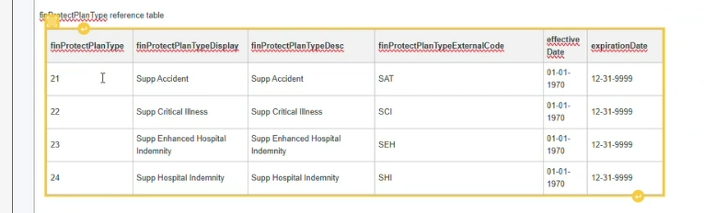
New finProtectPlanType Values for FlexWork

Slide 78
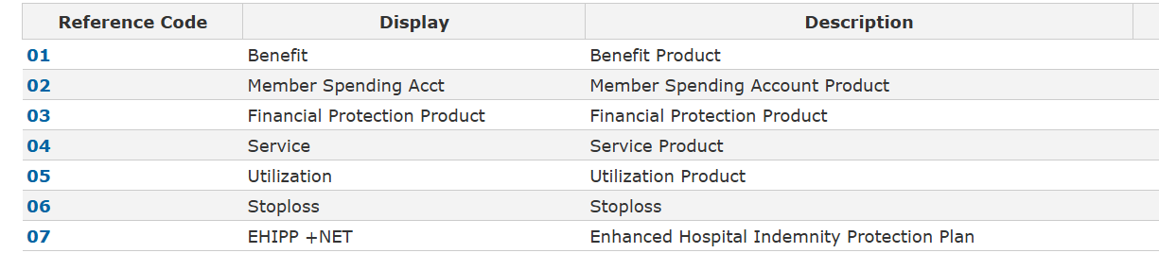
New productType Value for EHIPP + Net

Slide 79
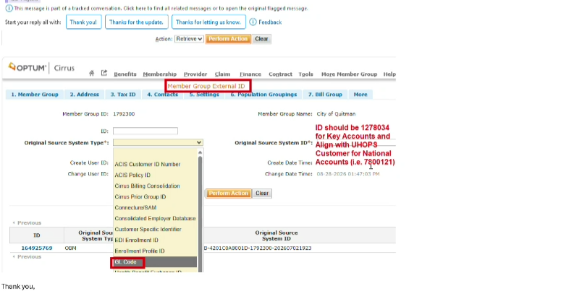
GL Code as Member Group External ID

Slide 80
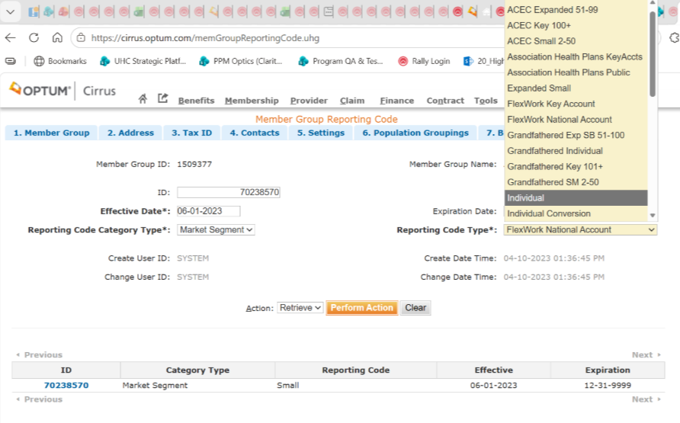
Reporting Code - FlexWork National Account & FlexWork Key Account

Slide 81
FlexWork Financial Tagging (C247971) - Application Impacts for PCMT, Membership Accounting & Revenue Tagging
Product Capability Family | Product Capability | Application/Team Name | Impact Description
Customer Management | Customer Implementation | OBM | Send new Bill Item Type for Collateral for customers that have provided a collateral in lieu of invoice payment delinquency. Add new values for market segment to distinguish between – - FlexWork National Account (FN) - FlexWork Key Account (FK) Send GL code assigned as Member Group External ID for FN
Customer Management | Customer Implementation | QIB - Cirrus Member Group | Add validation to ensure a valid combination of GL Code assignment member group external ID for FN market segment and appropriate LOBs. Add validation to ensure a valid combination of FK market segment and appropriate LOBs. Ensure appropriate Stop Loss Bill Item types are assigned based on ASL only (STOPLOSS_A) versus ASL and ISL (STOPLOSS_I, STOPLOSS_A) stop loss policy assignment. New Bill Item Type for Collateral. Associated Billing Schedule will have a flat $1.00 amount New finActivityCode for Collateral. Use existing HIP finActivityCode for EHIPP + Net
Data, Analytics & Reporting | Data Exchange (Internal & External) | DRA - NIMBUS | No Dev Impact Include new attribute memGroupContractPlanOption.finProtectPlanType on the PCMT to differentiate between the various standalone Financial Protection Plan offerings (HIP/CIP/APP) for Flexwork so as to enable accurate tagging for GL product. NOTE: Decision made during “FlexWork: Case Installation - GL code as Member Group External ID” meeting held on Monday, 9/21/26, that finProtectPlanType attribute not needed on PCMT productType attribute on the PCMT (existing attribute) can differentiate EHIPP + Net plan. Add the new attribute memGroupContractPlanOption.finProtectPlanType to FPP Membership Accounting PCMT and Membership Accounting test support
Financial Management | Financial Accounting & Reporting | FTS | Accept new attribute (finProtectPlanType) for Cirrus PCMT and load. This new attribute needs to be included in the Key Lookups for BRMS, Dental and Vision.

Slide 82
FlexWork Financial Tagging (C247971) - Application Impacts for PCMT, Membership Accounting & Revenue Tagging
Product Capability Family | Product Capability | Application/Team Name | Impact Description
Customer Billing | Billing Configuration | BRMS Revenue Finance Config (Jessica Constant’s Team and Karen Markiewicz) | Set up Rules for Revenue tagging in FTS Set up Rules for Collateral revenue (mimic CLAIM_FUND rules) – different BU and OU. Needs new finActivityCode for Collateral.
Customer Billing | Invoice Management | BRMS | Impact due to finProtectPlanType attribute on PCMT (lookup) Send finProtectPlanType attribute on transactions to FTS Take in new Bill Item Type and Billing Schedule for “Collateral”. Create billable charge template for “Collateral”
Customer Billing | Billing Configuration | BASICS | Take in new Bill Item Type for “Collateral” – set it up as “non-commissionable”
Financial Management | Financial Accounting & Reporting | UDW-Finance (FDF) | Accept new attribute (finProtectPlanType) on FPP Membership Accounting and load Send new attribute finProtectPlanType on transactions going to FTS for tagging

Slide 83
FlexWork Financial Tagging (C247971) - Application Impacts for Claim and Stop Loss Ledger Tagging
Product Capability Family | Product Capability | Application/Team Name | Impact Description
Product & Benefit Administration | Product Offering | Cirrus Config Team | Provide Financial Product Grid
Financial Management | Financial Operations Management | Cirrus Claims Financial Tagging Configuration (Karen Markiewicz’s Team) (Jena Kothbauer for Financial Protection plan claims) | Set up Rules for LF Claims A-side tagging in Cirrus Set up Rules for Financial Protection Claims Stop Loss/Ledger Only – no changes
Financial Management | Financial Operations Management | Claim Payment Finance Business (Karen Markiewicz and Shannon Reinbold) | Update cash disbursement grid
Claims Management | Claims Payment & Presentment | OFIN | Test Only - B-side tagging set up for Claim payments and Ledger only; Use appropriate bank account based on whether it is LF or FI claim; Claim Paid/Claim Payable Feed, Ledger/Stop Loss Feed
Financial Management | Financial Accounting & Reporting | UDW-Finance (FDF) | Test Only – Claim Paid/ Claim Payable Feed, Ledger/Stop Loss Feed

Slide 84
FlexWork Entity Reserve Administration Capability
Capability # | Rally Capability Name | Description
C247983 | FlexWork: Entity Reserve Administration | Supports scenarios where new or migrating customers may have mixed funding models, and distinct stop loss structures, while enforcing entity reserve paid‑through dates, and financial segregation rules.

Slide 85
FlexWork Entity Reserve Administration (C247983) Enhancements Overview
Traditional Level Funded groups typically operate with a single funding and entity reserve structure supporting both Individual Stop Loss (ISL) and Aggregate Stop Loss (ASL).
FlexWork introduces new scenarios where a customer may have:
FlexWork products with ASL-only coverage
Traditional Level Funded products with ISL and ASL coverage
Fully insured ancillary products operating alongside Level Funded medical offerings
These scenarios require enhanced reserve administration capabilities to properly segregate funds, accurately track liabilities, and support distinct stop loss arrangements.
Ability to maintain reserves for ASL-only FlexWork business independently from traditional ISL + ASL business
Handling of invoice payment for Flex Work customers with MEC & Bridge plan (“Aggregate Only” stop loss) resulting in accurate calculation of Entity Reserve Paid Thru date and Claim Fund amount.
Consistent handling of Aggregate Stop Loss calculations.
Alignment with existing Entity Reserve behaviors where stop loss protection activates once reserve funding thresholds are reached.

Slide 86

Level Funded Entity Reserve Process Flows – Current State

Slide 87
Entity Reserve Data Flow & FlexWork Impacts
Diagram Source

Slide 88
FlexWork Entity Reserve Administration (C247983) - Application Impacts
Product Capability Family | Product Capability | Application/Team Name | Impact Description
Customer Billing | Invoice Management | BRMS | - No Dev impact. Test Only for these areas: Create invoice for FlexWork customers with ASL only stop loss policy using Bill Item Type STOPLOSS_A only instead of regular standard Level Funded STOPLOSS_I and STOPLOSS_A Calculation of Paid Thru Date following current rules Continue sending messages in existing format over current Kafka with Paid Thru Date and subscriber list
Claims Management | Claims Adjudication | Cirrus Claim (Thor) | Test Only (Enhancement to Claim Post Adjudication “Entity Reserve” step to filter out claim lines that have Member Benefit revenueArrangement of “FI”, such as for Financial Protection plans, from being sent to Entity Reserve – already handled in the code) Needs analysis for Entity Reserve API changes – will be covered during feature design.
Financial Management | Reimbursement & Stop Loss | Cirrus Finance (Ghost Rider) | Enhancement to Entity Reserve/ASO Funding module to bypass ISL processing when Member Group’s assigned Stop Loss Policy is ASL only - look up whether just stoplossPolicyPeriodAgg exists (NO stoplossPolicyPeriodIndiv exists) Assumption is that the ASL only policy set up is accurate and validated during Case Install. No ISL accum creation or stoplossLedgerIndiv creation for ASL only member group entity reserve. Assumption - Existing ASL processor logic and ledger-offset behavior will be leveraged. Entity Reserve DM changes if needed will be determined during detailed (feature) design. Question to LF Finance Business - Is the Aggregate Accumulator UI or any other ASL specific UI needed? Not needed for now. Question - Are FlexWork customers going to be offered Level Funded Dental and Vision plans? No Any impact to taking in apGenerationResponse for partial recoveries (filter out if revenueArrangement is “FI”)? - No impact determined at this time Needs analysis for Entity Reserve API changes – will be covered during feature design.
88
88
88

Slide 89
FlexWork Entity Reserve Administration (C247983) - Application Impacts
Product Capability Family | Product Capability | Application/Team Name | Impact Description
Financial Management | Reimbursement & Stop Loss | OFIN | Test Only - Need to accept only ASL specific Ledger Entry transaction types for certain FlexWork customers that have ASL only stop loss IDB Spread - Test Only. No Dev impact, since there will be 2 separate invoices from BRMS Cash transfers – No Dev impact.
Financial Management | Reimbursement & Stop Loss | UDW-Finance/FDF | Test Only for Stoploss Ledger Feed.
Data, Analytics & Reporting | Operational & Analytical Reporting | DRA - R&A (Level Funded Operational Reporting team – Kay Buck’s team) | Daily Reconciliation reporting and any other reports – Business owned (3 Entity Reserve reports were identified as impacted)
Data, Analytics & Reporting | Pricing, Analytics & UW (PAU) | DRA - Stratus | Executive Summary Report – For FlexWork customers that do not have Individual Stop Loss, see following approach approved by Level Funded Business: Overall approach provided by Ed Krenz: We will take a parity approach for our flex work Executive summary reports. That means that any instance within the reports where the customer does not have Individual Stoploss, any reference to individual stop loss financial information will be zero out. On the first page instead of displaying 999999999 for the Specific deductible, it will be populated with N/A Also, the page that displays the members that have met 50% of their deductible, those pages will be omitted when the customer has no individual stop loss. Testing of actuarial and other reports.
89
89
89

Slide 90
C255314 Claim Intake

Slide 91
C255314 FlexWork Claim Intake Enhancements Overview
Draft
Overview
Claim intake is an existing capability in Cirrus today, with robust workflows to support the ingestion of multiple Claim types from several sources and to prepare them for adjudication.
With the FlexWork initiative, we will enhance functionality to support additional requirements as outlined on the next several slides.
Note that this Capability is specific to the FlexWork: Claims Intake & Validation (New Business) Capability, while a separate Capability (C278175) will support FlexWork: Claims Intake & Validation (Migration).

Slide 92
C278175 FlexWork Claim Intake (New Business) – Solution Approach
Draft
Intake Type | Solution Approach | Impacted Team(s)
Electronic Chargeable (Prof / Inst) | Submitted by Provider, routes from Clearinghouse to Cirrus using existing functionality Adjudication will assign a C1 adjudicationType to the Claim using existing functionality Subsequent adjudication steps (as part of the C247976: Claims Adjudication capability) will determine if the C1 Claim needs to remain as is, change to a C3 (for Standalone Indemnity plans) or Copy to a C3 (for Bridge plans) | None
Paper Chargeable (Prof / Inst) | Submitted by Provider or Member, routes to RMO RMO will key in the Claim and route the Claim to Cirrus using existing functionality Subsequent adjudication steps (as part of the C247976: Claims Adjudication capability) will determine if the C1 Claim needs to remain as is, change to a C3 (for Standalone Indemnity plans) or Copy to a C3 (for Bridge plans) Rx Reimbursement Claims are handled under C247975 FlexWork: Rx Reimbursement (EHIPP +NET) | None
Electronic Rx Encounters | Submitted by Optum Rx using existing functionality Adjudication will assign an E3 adjudicationType to the Claim using existing functionality No changes to adjudication Additional logic to create Member Rx Reimbursement Claims from the Rx Encounters will be covered under C247975 FlexWork: Rx Reimbursement (EHIPP +NET) | None
Member Rx Reimbursement | Submitted by Member via FlexWork portal or by mail These Claims are handled under C247975 FlexWork: Rx Reimbursement (EHIPP +NET) | None
Continued on next slide
92
92
92

Slide 93
C278175 FlexWork Claim Intake (New Business) – Solution Approach (continued)
Draft
Intake Type | Solution Approach | Impacted Team(s)
Electronic Corrected Chargeable (Prof / Inst) | Submitted by Provider with Frequency Code 7, routes from Clearinghouse to Cirrus using existing functionality Claim Intake process will apply the following logic: If the matched Claim in History is for a standalone Medical or Indemnity Plan (e.g. there is no Claim ID in the ‘Copy From/To’ fields), no change If the matched Claim in History is for a Bridge Plan (e.g. there is a Claim ID in the ‘Copy From/To’ fields), route the Claim to the Claim Envelope Queue (similar to the current Split Claim Handling logic) with new SOP for handling | Thor Business SOP
Electronic Cancelled Chargeable (Prof / Inst) | Submitted by Provider with Frequency Code 8, routes from Clearinghouse to Cirrus using existing functionality Claim Intake process will apply the following logic: If the matched Claim in History is for a standalone Medical or Indemnity Plan (e.g. there is no Claim ID in the ‘Copy From/To’ fields), no change If the matched Claim in History is for a Bridge Plan (e.g. there is a Claim ID in the ‘Copy From/To’ fields), route the Claim to the Claim Envelope Queue (similar to the current Split Claim Handling logic) with new SOP for handling | Thor Business SOP
Medicaid Reclamation Claims | Submitted by Reclamation Vendor, routes from Clearinghouse to Cirrus using existing functionality Adjudication changes for Medicaid Reclamation Claims are being handled as part of the C247976: Claims Adjudication capability | None
Indemnified Claims | Only applicable to NICE Book of Business, not FlexWork | None
COB Claims | Any enhancements for COB Claims are being handled as part of the C247976: Claims Adjudication capability | None
Continued on next slide
93
93
93

Slide 94
C278175 FlexWork Claim Intake (New Business) – Solution Approach (continued)
Draft
Additional Scenarios | Solution Approach | Impacted Team(s)
Manual Rebill |  | Thor
Claim Reset | If a user tries to cancel a C1 or C3 claim that has an ID in the ‘copy to/from’ field, the system will display an error saying it’s not allowed using the utility If a user tries to cancel a C4 claim, the system will display an error saying it’s not allowed | Thor
Manual Cancel of a Bridge Plan EHIPP+NET Claim (C3) | If the C3 claim is part of the bridge plan where a C1 claim exists and C3 is ‘pay to provider’, show an alert on the UI that the corresponding C1 claim needs to be reviewed for Cancellation, and allow cancellation of the C3 claim If the C3 claim is part of the bridge plan where a C1 claim exists and the C3 is ‘pay to member’, show an alert on the UI that the corresponding C1 claim needs to be reviewed for Cancellation but do not allow the C3 to be cancelled | Thor
Manual Cancel of a Bridge Plan Medical Claim (C1) | If the C1 claim is part of the bridge plan where a C3 claim exists and the C3 is ‘pay to provider’, show an alert on the UI that the corresponding C3 claim needs to be reviewed for Cancellation, and allow the cancellation of the C1 claim If the C1 claim is part of the bridge plan where a C3 claim exists and the C3 is ‘pay to member’, allow the cancellation of the C1 claim. During Feature solutioning we can decide if we also want to display a warning that a corresponding C3 exists but it is not allowed to be cancelled. | Thor
Manual Cancel of a Companion Claim (C4) | If a user tries to Cancel a C4 claim, the system will display an error not allowing it | Thor
94
94
94

Slide 95
C255314 FlexWork Claim Intake Enhancements
Draft
Assumptions
Existing ESOC controls will be leveraged for all of the Intake processes, no new controls are needed at this time
Additional details will be added soon for C278175 to support FlexWork: Claims Intake & Validation (Migration) and will include requirements related to Cross-Migration and Misrouted Claims, concepts that are not relevant for New Business.
  New Business Claims will contain the UHC Payer ID of 87726
  Cross-Migration and Misrouted Claims may involve the UHOPS Payer ID of 81400
FlexWork Medical and EHIPP+Net (standalone and with Bridge plan) will route to USP
FlexWork Dental Claims will route to Dental Facets
FlexWork Vision Claims will route to VAS
FlexWork Indemnity Claims other than EHIPP+NET (i.e. EHIPP/HIPP, Accident, Critical Illness, Life and Short-Term Disability) will route to OnBase

Slide 96
C255314 FlexWork Claim Intake (NEW BUSINESS) - Application Impacts
Draft
Product Capability Family | Product Capability | Application/Team Name | Impact Description
Claims Management | Claims Pre-Processing | Cirrus / Thor | Load Corrected Claim updates Load Cancel Claim updates Claim Reset Utility updates Manual Claim cancel updates Manual Rebill updates? (TBD)
Claims Management | Claims Pre-Processing | Business | Create SOPs for handling Corrected and Cancel Claims that drop to the Claim Envelope queue
96
96
96

Slide 97
C278175 FlexWork Claim Intake (MIGRATION) - Application Impacts
Draft
Product Capability Family | Product Capability | Application/Team Name | Impact Description
Claims Management | Claims Pre-Processing | Cirrus / Thor
Claims Management | Claims Pre-Processing | RMO
Claims Management | Claims Pre-Processing | FlexWork Member Portal
Claims Management | Claims Pre-Processing | Upstream (OI/MGD, CRE/CPE, CHWY, etc)
To be updated
97
97
97

Slide 98
C247975 Rx Reimbursement

Slide 99
FlexWork Rx Reimbursement Enhancements Overview
Draft
Rx Reimbursement is a new concept for Cirrus. FlexWork members with the Rx Reimbursement benefit on their EHIPP+NET Plan are allowed $10 Rx reimbursement per Date of Service, up to 12 reimbursements per year for prescriptions.
  This benefit is only available for existing FlexWork plans, it is not offered as a New Business Plan benefit. This means it will come into play for Migrating customers only.
Example:
Member picks up 1 Rx at Pharmacy on 1/15/2026 and pays out of pocket cost share
Member can receive $10 reimbursement, regardless of what they paid out of pocket (e.g. whether they paid $5, $25, $100, etc) as long as they haven’t reached their daily/annual maximum reimbursement limit
Example:
Member picks up 3 Rx at Pharmacy on 1/22/2026 and pays out of pocket cost share
Member can receive $10, regardless of what they paid out of pocket as long as they haven’t reached their daily/annual maximum reimbursement limit

Slide 100
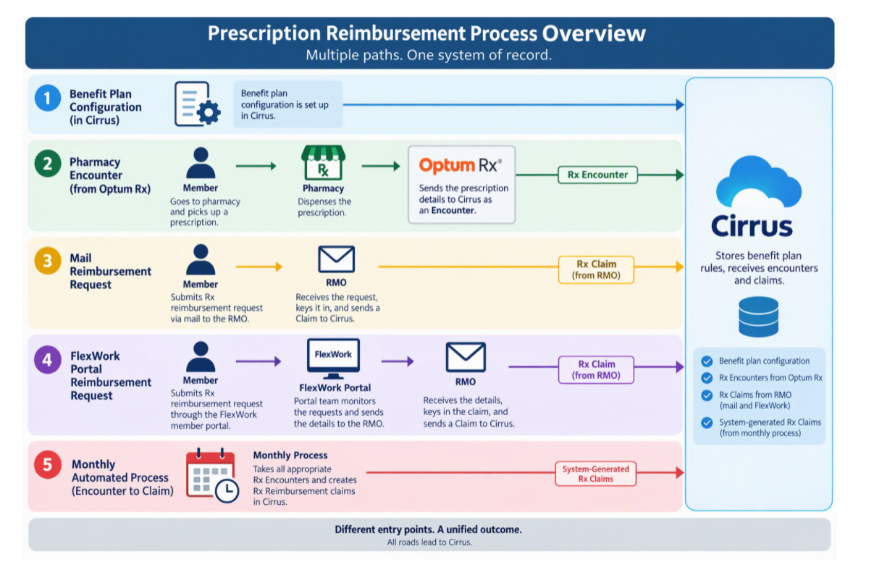
FlexWork Rx Reimbursement Enhancements Overview
Draft
This diagram outlines the overall Rx Reimbursement process, showing how the different components for this Capability fit together.
(Note: the diagram was generated by AI and I would still like to wordsmith a few pieces but wanted to include it as a reference starting point since AI is having trouble making updates!)

Slide 101
FlexWork Rx Reimbursement Enhancements Overview
Draft
The following slides describe the different solution components for this Capability along with their impacted Team(s). Note that some of the components will be delivered as part of other Capabilities.
Solution Component | Solution Approach | Impacted Team(s)
Rx Reimbursement Benefit on EHIPP+NET Plan setup | The Rx Reimbursement Benefit on the EHIPP+NET Plans will be set up as part of the C262550 FlexWork: EHIPP +NET Product capability. This will also include the configuration for the $10 per DOS limit and the 12 Days per Year limit. No changes are needed for )this Component in this Capability. | None
Rx Encounter Intake and Processing | Rx Encounters for FlexWork members will route to Cirrus from OptumRx following the process that exists today for existing Cirrus members. No changes are needed to the daily feed from OptumRx nor to the Adjudication Logic in Cirrus for handling the Rx Encounters. | None
Member Submitted Paper Rx Reimbursement Request | Member-submitted paper Rx Reimbursement requests will be received at the RMO (volumes are expected to be less than 20 per year). The RMO will need an updated SOP with instructions on how to key in these Claims for Cirrus as the instructions will be slightly different than the process today for these Claims that are keyed in for UHOPS. Instructions will include details such as the dummy Provider ID, dedicated CPT code, default diagnosis code, default Place of Service, etc. During Feature Solutioning, these details can be further refined. | RMO
Member Submitted Portal Rx Reimbursement Request | Members can continue to use the FlexWork portal (not the myUHC portal) to submit Rx Reimbursement Requests (volumes are expected to be less than 5 per year). The FlexWork portal team will monitor for submissions and will forward the requests to the RMO for the RMO to key in and route to Cirrus. RMO will follow the same new SOP to key in these Claims that they will use for Member-submitted paper Rx Reimbursement requests. | FlexWork Member Portal SOP RMO
Assignment of Cirrus adjudicationType | The adjudicationType Rule Service in Cirrus will be updated to include new properties and a new Rule to derive the C3 adjudicationType for these Rx Reimbursement Claims. While other Claims in Cirrus will receive a C3 adjudicationType when the Claim is created (via the ‘Copy Claim’ functionality as part of the C247976: Claims Adjudication Capability), we need to have a rule set up to systematically assign these new Claims with the proper adjudicationType when Rx Reimbursement Claims come to Cirrus via the Intake process. During Feature Solutioning, we can decide which properties will be needed for this new rule, potentially the CPT code and/or dummy Provider ID along with potentially using RMO as the source. | Thor
Continued on next slide

Slide 102
FlexWork Rx Reimbursement Enhancements Overview
Draft
Solution Component | Solution Approach | Impacted Team(s)
Monthly Process to Generate Reimbursement Claims from Encounters | We have two options to accomplish this piece – and discussions are ongoing to decide which Option will be selected. Option 1: Manual / Alternative Automation Solution Team will generate a monthly extract of prior month Rx Encounters (generally around the 8th of each month) for FlexWork members who have the Rx Reimbursement benefit. Will include Encounters with DOS (fill date) in the prior month. Extract will be reconciled to remove reversals and duplicates, and will result in a list organized by Member and DOS Process will use existing or modified bot/RPA to create one claim (adjudicationType = C3) per member, with a $10 line per eligible DOS, using defined values for Provider, CPT, diagnosis, POS, etc. Claims will then be routed to the Cirrus adjudication engine for adjudication Option 2: Systematic Solution System will generate a monthly extract of prior month Rx Encounters (generally around the 8th of each month) for FlexWork members who have the Rx Reimbursement benefit. Will include Encounters with DOS (fill date) in the prior month. Monthly Extract will be systematically reconciled to remove reversals and duplicates, and will result in a list organized by Member and DOS System will use extract to create one claim (adjudicationType = C3) per member, with a $10 line per eligible DOS, using defined values for Provider, CPT, diagnosis, POS, etc. Claims will then be routed to the Cirrus adjudication engine for adjudication | Alternative Automation or Thor
Adjudication of Rx Reimbursement Claims | Adjudication of these Rx Reimbursement Claims will be handled in the C247976: Claims Adjudication Capability. Logic will include making sure the Member has the Rx Reimbursement benefit, that they haven’t already received reimbursement for that DOS and that they haven’t exceeded their annual maximum limit (Claim will deny if limit exceeded). Additionally, there will be an EOB but no PRA generated. During adjudication, if the member’s accumulator bucket hasn’t been created yet for this Benefit, it will be created and updated (similar to existing logic for other accumulator buckets). | None

Slide 103
FlexWork Rx Reimbursement- Application Impacts
Draft
Product Capability Family | Product Capability | Application/Team Name | Impact Description
Claims Management | Claims Adjudication | Cirrus / Thor | Add property (or properties) to adjudicationType rule service and add rule for C3 adjudicationType If Option 2 is chosen for the monthly batch process, Thor would have to generate an extract for the appropriate FlexWork members who are eligible for Rx Reimbursement and create the Rx Reimbursement Claims for adjudication from the reconciled extract
Claims Management | Claims Adjudication | Alternative Automation | If Option 1 is chosen for the monthly batch process, the Alternative Automation Team would have to generate an extract for the appropriate FlexWork members who are eligible for Rx Reimbursement and create the Rx Reimbursement Claims for adjudication from the reconciled extract
Claims Management | Claims Pre-Processing | RMO | RMO will need instructions on how to key in the Rx Reimbursement Claims when they receive a paper Claim from a member or Claim details from the FlexWork Member Portal team. Today, the RMO has instructions for keying in the Claims for UHOPS but Cirrus will have different values for CPT code, diagnosis code, Provider ID and other default values.
Claims Management | Claims Pre-Processing | FlexWork Member Portal | The FlexWork Member Portal team will need to identify when a Member submits an Rx Reimbursement request through the portal and will forward that information to the RMO so the Claim can be keyed in.
103
103
103

Slide 104
FlexWork Rx Reimbursement Enhancements Overview
Draft
Assumptions
If we already reconciled the Encounters for a given month (ex, October) and we receive an Encounter cancellation in a subsequent month (ex, November), we do not need to re-reconcile that Cancelled Encounter or take back any Rx Reimbursements that we would’ve created.
Dependencies
All FlexWork EHIPP+NET Benefit Plans with the Rx Reimbursement Benefit must be configured in Cirrus
Existing USP Controls (e.g. ESOC controls) will be used as they are today with no changes needed for this capabliity

Slide 105
C255287 Timely Filing & Prompt Pay

Slide 106
C255287 FlexWork Timely Filing & Prompt Pay Enhancements
Draft
Timely Filing and Prompt Pay
Timely Filing – the time by which a claim has to be submitted to the insurance company by the Provider or Member or a penalty (up to full denial) can be applied
Prompt Pay – the time by which the insurance company has to pay the claim before interest/penalty can be applied
While these two important adjudication steps are combined in this capability, they will be solutioned for separately since they cover mutually exclusive adjudication steps, configuration and workflows.

Slide 107
C255287 FlexWork Timely Filing & Prompt Pay Enhancements
Draft
Timely Filing Solution Approach
Current State
Logic implemented for Medical Plans to follow Fully Insured, ASO and Level Funded rules
  Filing Limit based on ‘winner’ of applicable candidates (State/Federal Guardrails, Provider/Network Contract, Benefit Plan, Member Group, Benefit Code)
    ‘Applicable candidates’ decided by Funding Source and Par Status
  Claims that exceed Filing Limit without attachments are either fully or partially denied, depending on the rules for the Filing Limit ‘winner’
  Claims that exceed Filing Limit with attachments drop to manual for review

Slide 108
C255287 FlexWork Timely Filing & Prompt Pay Enhancements
Draft
Timely Filing Solution Approach (continued)
Future State
No change to existing logic for Medical (FI, ASO, LF) Plans/Claims
  FlexWork Medical plans will follow existing Level-Funded logic
FlexWork EHIPP+NET Indemnity plans will follow new logic:
  OON limit is 15 months
    Timely Filing Schedule configured with this OON limit will be assigned to all FlexWork EHIPP+NET Benefit Plans
  INN limit follows Provider contract
    Timely Filing limits will be defined in Cirrus on the Provider contracts
  Timely Filing adjudication step will be updated to implement new logic for FlexWork EHIPP+NET Benefit Plans
    New logic will be applicable to C3/C4 adjudicationTypes

Slide 109
C255287 FlexWork Timely Filing & Prompt Pay Enhancements
Draft
Timely Filing Solution Approach (continued)
Assumptions
EHIPP+NET will use the existing Timely Filing Claim edits (FLXXX) that are used for Medical Plans
No new Timely Filing remark codes are needed for FlexWork Medical or Indemnity Plans
Surest ASO C242454 is being implemented separately (currently in flight) and will cover ASO/LF logic for FlexWork Medical plans
Corrected Claim Timely Filing ST22917 is being implemented separately (currently solutioning) and will cover handling of Corrected Claims for Medical and Indemnity Plans
Medicaid Reclamation Claims for FlexWork Medical and Indemnity plans will follow existing Medicaid Reclamation logic (e.g. rules defined for Vendor States)

Slide 110
C255287 FlexWork Timely Filing & Prompt Pay Enhancements
Draft
Prompt Pay Solution Approach
Current State
Logic implemented for Medical Plans to follow Fully Insured, ASO and Level Funded rules
  Prompt Pay Due Date and Interest rules based on ‘winner’ of applicable candidates (State/Federal Guardrails) along with additional SLA timelines (Benefit Plan, Member Group, etc.)
    Prompt Pay logic includes a hierarchy using State ‘applicability type’ to determine the winner

Slide 111
C255287 FlexWork Timely Filing & Prompt Pay Enhancements
Draft
Prompt Pay Solution Approach (continued)
Future State
No change to existing logic for Medical (FI, ASO, LF) Plans/Claims
  FlexWork Medical plans will follow existing Level-Funded logic
FlexWork EHIPP+NET Indemnity plans will follow new logic:
  New Indemnity Plan Prompt Pay Schedule will be configured and assigned on the Regulatory Entity State Guardrail
  Not all States have Indemnity Prompt Pay Rules – those states will use ‘Due Date Not Applicable’ existing logic and use the default System Generic Due Date
  There is no ‘hierarchy’ concept for Indemnity Plans, Cirrus will simply use the rules of the Member Group Situs state
  Additional field will be added to the Interest Schedule to identify the starting point for interest accrual
    For current state logic, interest accrues from due date
    Some States have rules for Indemnity plans that dictate interest is accrued from Receipt Date as opposed to Due Date
  Requirement for exclusion from TX queues?
Prompt Pay adjudication step will be updated to implement new logic for FlexWork EHIPP+NET Benefit Plans
  New logic will be applicable for C3/C4 adjudicationTypes

Slide 112
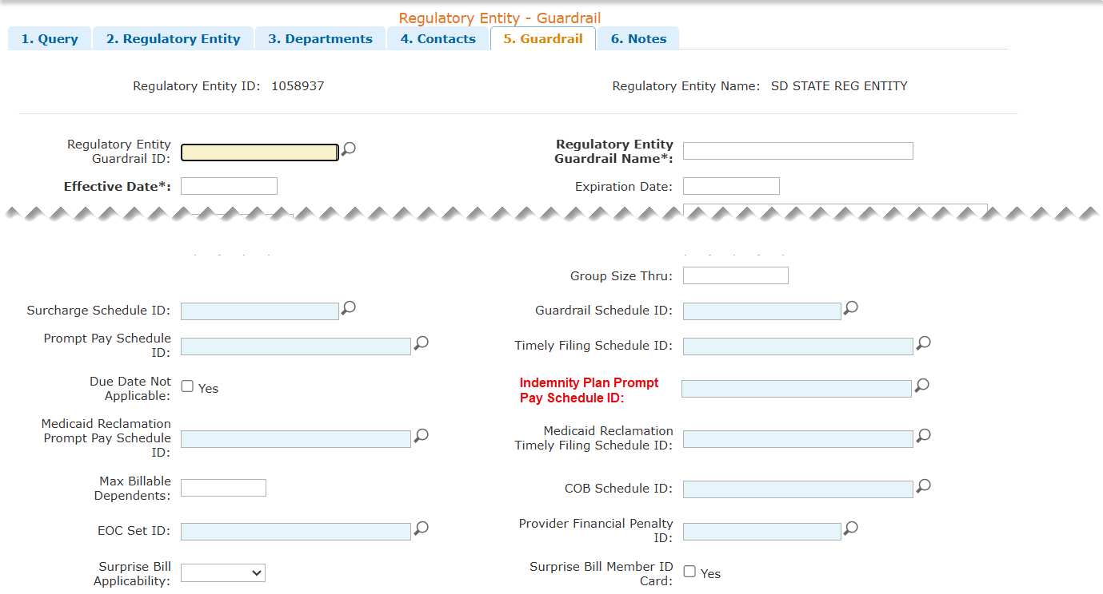
C255287 FlexWork Timely Filing & Prompt Pay Enhancements
Draft
Regulatory Entity Guardrail proposed changes
Note 11/4 CP – approach has been updated based on discussions with Benefit and Config teams. Will add details here

Slide 113
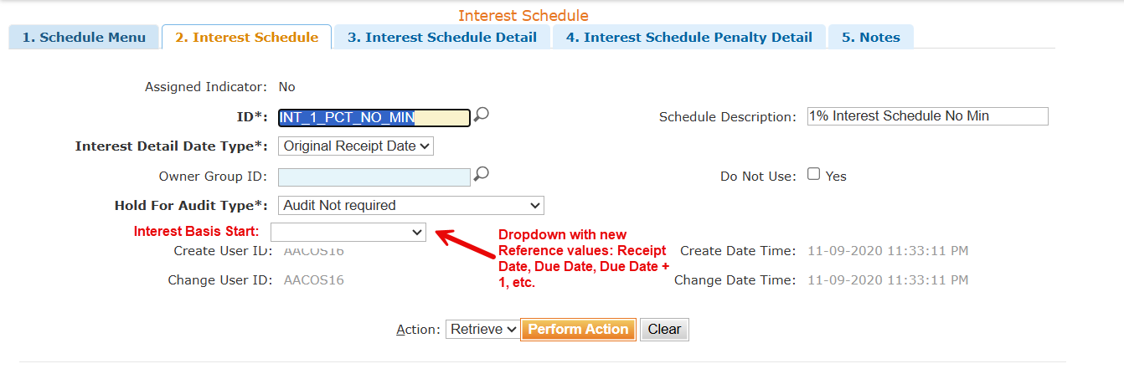
C255287 FlexWork Timely Filing & Prompt Pay Enhancements
Draft
Interest Schedule proposed changes

Slide 114
C255287 FlexWork Timely Filing & Prompt Pay Enhancements
Draft
Prompt Pay Solution Approach (continued)
Assumptions
EHIPP+NET will use the existing Prompt Pay Claim edits (DDXXX) that are used for Medical Plans when appropriate (not all of the existing ones will be relevant)
Medicaid Reclamation Claims for FlexWork Medical and Indemnity plans will follow existing Medicaid Reclamation logic (e.g. rules defined for Vendor States)

Slide 115
C255287 FlexWork Claim Timely Filing & Prompt Pay - Application Impacts
Draft
Product Capability Family | Product Capability | Application/Team Name | Impact Description
Claims Management | Claims Adjudication | Cirrus / Thor | Timely Filing Update workflow for Indemnity Claims to use Benefit Plan config for OON and Provider Contract for INN Prompt Pay Update workflow for Indemnity Claims to use Guardrail config for MG Situs State Update CPS Step to calculate Interest Basis Date using new field from Interest schedule
Claims Management | Claims Adjudication | Cirrus / Config | Timely Filing Assign Timely Filing schedule to Indemnity Benefit Plans (can use existing TF schedule with only an OON record configured for 15 months) If details are submitted before plans are created, can make it part of that process, or do as rework afterward Update configuration for existing Timely Filing Limit edits (FLXXX) to work with new C3/C4 claims’ Prompt Pay Configure Prompt Pay schedules for Indemnity Claim states Configure Interest Schedules for Indemnity Claim states Configure State Guardrails for new Indemnity Prompt Pay Schedule ID
Claims Management | Claims Adjudication | Cirrus / Ghost Rider | Timely Filing N/A Prompt Pay Add Interest Basis Start field to Interest Schedule data model, UI and new reference for dropdown Data remediation for existing Interest Schedules
115
115
115

Slide 116
C255287 FlexWork Claim Timely Filing & Prompt Pay - Application Impacts
Draft
Product Capability Family | Product Capability | Application/Team Name | Impact Description
Claims Management | Claims Adjudication | Cirrus / Valkyrie | Timely Filing N/A Prompt Pay Add new field on Regulatory Entity Guardrail data model and UI for Indemnity Plan Prompt Pay Schedule
Claims Management | Claims Adjudication | OFIN | Timely Filing N/A Prompt Pay Exclude EHIPP+NET Claims from Medical TX queues? (TBD)
Claims Management | Claims Adjudication | Business | Timely Filing N/A Prompt Pay Process for gathering CT Indemnity claims to determine whether interest applies Notification process for when due days/interest rates/penalties change for EHIPP+NET state rules
116
116
116

Slide 117
C275172 Affordability & Payment Integrity

Slide 118
C275172 FlexWork Affordability and Payment Integrity
Overview
In USP/Cirrus today, there are multiple checkpoints and solutions for the applicable Affordability and Payment Integrity programs and their rules related to Medical Plans.
Some checkpoints are upstream before the Claims are loaded into Cirrus, some are within Cirrus adjudication steps and others are outside of Cirrus after claims are paid.
With FlexWork Indemnity Plans being implemented on Cirrus, we will need to account for inclusions/exclusions in these Affordability and Payment Integrity programs as required.
The grid on the following slides outline the applicability of each of these programs and the solution approach that is needed to meet the requirements.
Draft

Slide 119
C275172 FlexWork Affordability and Payment Integrity
Draft
# | Program Name | MEC | EHIPP + NET | Solution Approach
1 | ACE Editing | YES | YES | No impact, existing edits will run for Claims upstream
2 | EDC Analyzer | YES | YES | No impact, existing edits will run for Claims that are submitted to CES
3 | Fraud Waste and Abuse | YES | YES | No impact, existing configuration and processes will apply for Claims
4 | NDC reimbursement | YES | NO | No impact, no changes needed. Since it’s not an eligible benefit for EHIPP+NET, it will just deny
5 | OCM – Outlier Cost Management | N/A | N/A | N/A – this is UHOPS specific, not something that will be applicable to USP
6 | Recovery (includes OFFSET) | YES | YES | No Impact
7 | Bundling vs unbundling | YES | YES | No impact, existing edits will run for Claims that are submitted to CES
8 | Reimbursement Policy – follow UHC reimbursement policy | YES | YES | No impact, existing edits will run for Claims that are submitted to CES
9 | Facility / Prof reimbursement | YES | YES | No impact, existing edits will run for Claims that are submitted to CES
119
119
119

Slide 120
C275172 FlexWork Affordability and Payment Integrity
Draft
# | Program Name | MEC | EHIPP + NET | Solution Approach
10 | Subrogation | YES | NO | Config only changes to exclude C3/C4 from any Subrogation rules in the RSE. Also includes Business Process impact for Claims that are pulled from Cirrus
11 | Term Max Age | YES | YES | No Impact
12 | AIM Recovery | N/A | N/A | N/A – this is UHOPS specific, not something that will be applicable to USP
13 | High Dollar | YES | NO | Config only changes to exclude C3/C4 from RSE High Dollar rules
14 | COB | NO | NO | Covered with C247976 Claim Adjudication capability solution as it relates to Medicare Reclamation and Medicaid demands
15 | Itemized Bill Review | YES | NO | Config only changes to exclude C3/C4
16 | CLIA | YES | YES | No impact, existing rules will execute upstream and no changes needed
120
120
120

Slide 121
C275172 FlexWork Affordability and Payment Integrity- Application Impacts
Draft
Product Capability Family | Product Capability | Application/Team Name | Impact Description
Claims Management | Claims Adjudication | Cirrus / Thor | adjudicationType is already a property in the Vendor_Recommendation_Bypass rule service Add adjudicationType to the Adjudication_Audit rule service
Claims Management | Claims Adjudication | Cirrus / Config | Configuration to exclude C3/C4 adjudication types from certain vendor callouts
Claims Management | Claims Adjudication | Subro Teams | Exclude C3/C4 adjudication types from the post-pay Subro claim analysis Include for discussions: Kari Hollands, Pankaj Soni, Shelby Kampa, Nicholas Dascenza, Dina Anderson, Susan Raiford, Sandi Keebler, Jagadish Vasireddy Exclude C3/C4 adjudication types from Vendor post-pay Subro pulls Include for discussions: Valerie Zaric
121
121
121

Slide 122
Claims Payment & Presentment
(EOB/PRA and Check Summary)

Slide 123
FlexWork Claims Payment and Presentment Capability
Capability # | Rally Capability Name | Description
C247981 | FlexWork: Claims Payment and Presentment | Handling of multiple funding arrangements and multiple payees, ensuring separate payments are created for member payee and provider payee for a claim as well as separate payments are created for a claim adjudicated against Level Funded and Fully Insured plan.

Slide 124
FlexWork Claims Payment & Presentment (C247981) Enhancements Overview
FlexWork introduces a mixed-funding model within USP:
MEC/MVP medical products are Level Funded (LF).
EHIPP+/EHIPP+NET indemnity products are Fully Insured (FI).
A single member may have both medical and indemnity coverage through a Bridge Plan.
Because claims can adjudicate under different funding arrangements, USP must support specialized presentment and payment handling for FlexWork

Slide 125
EOB Overview
EOB (Explanation of Benefits) Generation
Purpose
The EOB remains the member-facing explanation of adjudication results and follows standard USP presentment patterns.
Recipient
EOBs are sent to the member
Subscriber payment and member communication are treated separately.
Generation Rules
Generated per adjudicated plan
EOBs are generated based on the applicable adjudicated plan, not merely by claim number.
Draft

Slide 126
EOB Overview
EOB Consolidation
USP supports EOB consolidation:
Based on member/card-code logic
Based on claim type
Multiple claims may appear in a single EOB within standard consolidation windows.
Standard USP Formatting for EOBs
FlexWork intends to use:
Standard USP templates
Standard USP branding
Standard USP remark codes where possible
FlexWork-specific remark codes only when needed.
Accumulator Display on EOBs
Medical plans show normal plan accumulators.
EHIPP+NET indemnity plans do not display traditional medical accumulators and limits.

Slide 127
PRA Overview
PRA (Provider Remittance Advice) Generation
Purpose
The PRA is the provider-facing payment remittance document.
Unlike EOBs, PRA generation is tied to the payment transaction, not the member.
Generation Rules
Generated per payment
A PRA is produced per provider payment, Not per member, Not per subscriber.
Consolidation
PRAs are consolidated according to:
Payment transaction
Bank account used to issue payment.
Therefore- Multiple claims may appear on one PRA.
A provider receiving one consolidated payment receives one consolidated PRA.

Slide 128
Check Summary Overview
Check Summary Generation (for Subscriber payments)
USP standard check summary behavior will be reused.
Generated at payment level
Consolidated payment presentation
Contains payment amounts only
No PHI
No detailed claim-level information.
Recipient
Check summary → Subscriber
EOB → Member
This separation is intentional to meet privacy requirements.

Slide 129
FlexWork Claims Payment & Presentment (C247981) EOB/PRA Key Challenges
Key Challenges in FlexWork EOB & PRA Generation
Claim Splitting and Duplicate Claims
The largest challenge is the need to support scenarios where a single member service may result in:
Multiple adjudications
Multiple claim IDs
Different payment recipients (provider and/or subscriber)
The team discussed creating separate claims for FlexWork Medical and EHIPP+NET adjudication outcomes, but this creates uncertainty around how EOBs and PRAs should be generated and linked.
Why this is difficult
Current presentment processes assume a more straightforward relationship between:
Claim
ICN
Payment
EOB/PRA
FlexWork may introduce situations where one claim business event results in multiple adjudicated claims.
Draft

Slide 130
FlexWork EOB, PRA and Check Summary – Proposed Solution
Overview
FlexWork Bridge plans require a single submitted claim to be evaluated independently under two funding arrangements:
Level Funded Medical
Fully Insured EHIPP+NET financial protection
The recommended solution is to use separate, linked claims and payment records rather than combining Medical and EHIPP+NET activity on one claim. This approach preserves funding separation, supports different adjudication rules, enables separate payment and presentment to both providers and members for EHIPP+NET activity, and maintains clear financial and document traceability. The direction is documented in Flexwork Working Document.pptx

Slide 131
Recommended solution
1. Separate Medical and EHIPP+NET adjudication
For a Bridge plan, Cirrus will create a copy of original claim submission for adjudication under EHIPP+NET plan:
The original will be adjudicated only against the Level Funded Medical plan.
The copy will be adjudicated only against the Fully Insured financial protection plan.
The claims will be processed independently without COB. Each claim will have its own claim ID, adjudication result, Claim Pay Summary, payment request, and presentment artifacts. This separation allows Medical and EHIPP+NET to apply their respective funding, delinquency, payment-integrity, prompt-pay, recovery, and financial-processing rules
2. Companion claim for member payments
EHIPP+NET may further pay:
The provider only.
The member only.
The provider up to the allowed amount, with the remaining fixed-cash benefit paid to the member.
Where both provider and member payments are required, the EHIPP+NET primary claim will represent the provider payment, and a linked companion claim will represent the member payment. This avoids the current Cirrus limitation of supporting two payees on one claim and prevents member reimbursement information from appearing on the provider PRA.

Slide 132
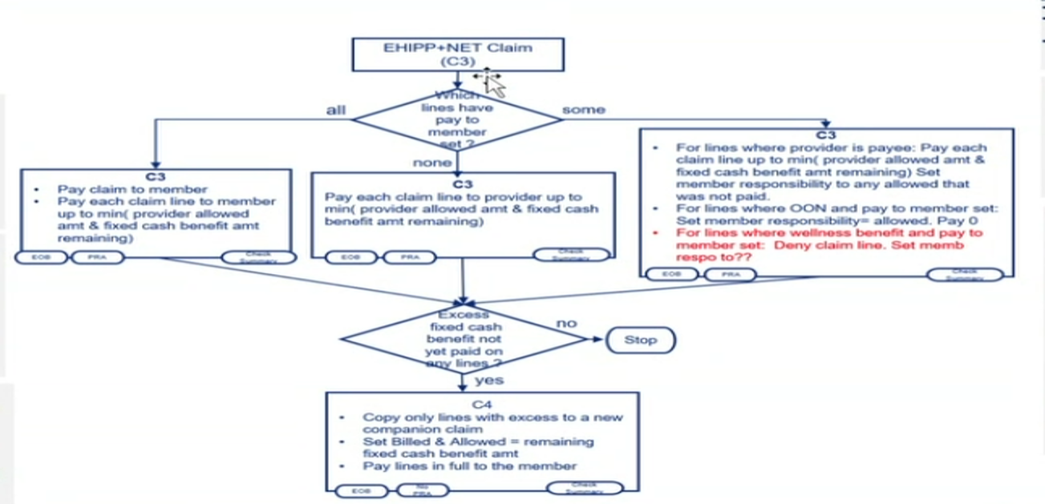
C3 and C4 Adjudication Type Overview
The original claim’s adjudication type should remain “Chargeable C1” for medical.
C3 and C4 are new adjudication types being introduced to support the EHIPP+NET / two-payee reimbursement model.

Slide 133
C3 and C4 Adjudication Type Overview
C3 Adjudication Type
The EHIPP+NET claim will use a C3 adjudication type. The original chargeable medical claim can spawn an EHIPP+NET copy claim with a new adjudication type such as “Chargeable C3”.
A C3 claim is adjudicated through the claim-processing flow, although certain adjudication steps or CES rules may be bypassed or configured differently for this claim type.
Member reimbursement does not occur from the C3 claim itself, except when there is a member payment needed for a wellness benefit code or OON benefits or Rx reimbursement
PRA is always generated for C3 (except for cases when it is member payment for a wellness benefit code)
C4 Adjudication Type
C4 will be used for the companion claim associated with a C3 claim.
The C4 claim is used for the two-payee/member payment portion of the process. A member would receive payment usually from a C4 claim and in certain exception cases, from a C3 claim.
PRA should not be generated for C4 claims. (PRA suppression indicator will be set to “C” in Claim Pay Summary logic to suppress PRA)

Slide 134
Guidelines for EOB and PRA
Create EOB for every claim, except for Accum/Benefit Rejournal action.
Create PRA for all C3 EHIPP+ NET, except those that require Member Payments and C4 (These are Member payments - will have default providers allowing for Direct Pay – like solution)
Do not create EOB or PRA for Accum/Benefit Rejournal Actions.
(The Rejournal solution will leverage existing attributes on Claim payable for EOB or PRA suppression:
/claimPaymentOutbound/transactionHeader/eobSuppressionType
/claimPaymentOutbound/transactionHeader/praSuppressionType)

Slide 135
Rules
C1 - always generate EOB & PRA
C3 - always generate EOB & PRA with 1 exception (wellness benefit paid to member)
C4 - EOB Only

Slide 136
FlexWork EOB Scenario
This is because medical and indemnity adjudications will be processed independently.
Scenario | EOB Outcome
MEC claim only | One medical EOB
EHIPP+NET claim only | One indemnity EOB
Bridge Plan claim adjudicated under MEC and EHIPP+NET | Potentially multiple EOBs

Slide 137
FlexWork Check Summary and Payment Funding Source
Check Summary Generation
Recipient Logic
Payments are issued to the subscriber, not to the covered member
Funding Source Rules
Payment source depends on adjudication type (payment routing relies on correct funding classification)
:
Claim Type | Funding Source
MEC/MVP Medical | Level Funded bank account
EHIPP+NET | Fully Insured bank account
Member reimbursement under EHIPP+NET | Fully Insured bank account
Draft

Slide 138
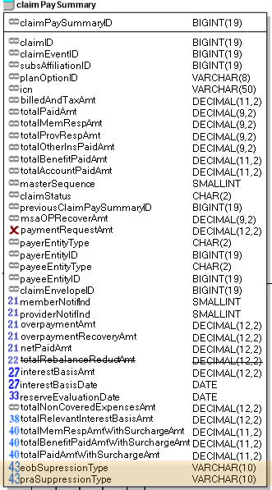
“Rejournal”
Fields on the ClaimPaySummary define what type of suppression of the EOB/PRA is to occur at the claim level, when ‘No Suppression’ there is no suppression.
Reference values were added that will be used by both the ‘eobSuppressionType’ and ‘praSuppressionType’ fields. ‘No Suppression’ will be the default value
New ClaimEventSubType reference value will be added:
referenceName | referenceCode | referenceDisplay | Expected Outcome
suppressionType | N | No Suppression | No Suppression
suppressionType | P | Suppress Printing | Print Suppression. EOB or PRA will still appear in Portal.
suppressionType | C | Suppress Creation | Creation Suppression. EOB or PRA will not be printed or in portal.
referenceName | referenceCode | referenceDisplay | referenceDesc
claimEventSubType | xx | Accum/Benefit Re-Journal | Accum Re-Journal

Slide 139
Ghost Rider EOB/PRA Suppression Enhancements
Two new fields will be added to the payment request to OFIN: eobSuppressionType and praSuppressionType
  These values will be mapped from the columns of the same name in the Claim Pay Summary table (Already done)
eobPrintSuppressionInd will be removed and replaced with eobPrintSuppressionType = ‘Print’. The logic to set this will emulate the current Ghost Rider logic and be placed in the Claim Pay Summary step of adjudication.
This work will take place using a toggle shared with the associated Claims Development team work to add the new fields and add the print suppression logic currently done ‘on the fly’ in the payment request to OFIN
New field will be added for claimEventSubType in the payment request. (Already done) - A value of xx indicates Accum/Benefit Re-Journal
Mimic the logic for DOFR Rejournal adjustments for this new “Accum/Benefit Rejournal” adjustment.

Slide 140
OFIN EOB/PRA Suppression Enhancements
When OFIN receives values of both eobSuppressionType and praSuppressionType of ‘C’, OFIN will suppress the EOB/PRA by not sending the payment request to Payment Engine. Payment Feedback will still occur, and these Claims will still appear on the Paid Claims Feed to FDF.
OFIN must be able to use the new eobPrintSuppressionType = ‘Print’ to communicate print suppression downstream as the eobPrintSuppressionInd will be no longer supported.
Payment Feedback must still be provided as well as downstream financial feeds other than to downstream applications responsible for generating the EOB/PRA.

Slide 141
Artifact Impacts
EOB
The solution will create an EOB for each physical claim:
Medical EOB for Medical adjudication.
EHIPP+NET EOB for the primary EHIPP+NET claim.
Companion EOB for a separate member payment, when applicable.
A Bridge scenario involving both plans and an EHIPP+NET residual member payment can therefore produce three EOBs. Each EOB will reflect only the adjudication and payment recorded on its associated claim.

Slide 142
Artifact Impacts
PRA and 835
Separate PRAs will be generated for provider-facing Medical and EHIPP+NET claims. The provider PRA must not expose amounts paid separately to the member.
For a member-only companion claim:
The member receives an EOB, and the subscriber receives a payment (Check Summary).
The provider PRA is suppressed.
The claim remains linked to the EHIPP+NET primary claim for operational traceability.
PRA suppression can be achieved through using a “Benefit/Accum Rejournal” claim event sub-type like the “DOFR Rejournal”

Slide 143
Artifact Impacts
Check Summary or Health Statement
The Check Summary is primarily associated with Fully Insured EHIPP+NET member payments. It should:
Explain the fixed-cash or residual amount paid to the subscriber.
Align with the companion-claim EOB.
Exclude provider-remittance information.
Avoid displaying internal fixed-cash accumulator or reimbursement-limit calculations unless the business requirement changes.
The detailed Check Summary template and generation rules remain to be finalized.

Slide 144
FlexWork Claims Payment & Presentment (C247981) EOB/PRA and Check Payment Enhancements Overview
Portal / Document Delivery
Member Self Service/OAP (Optum Adaptive Portal) will be the member portal for FlexWork.
The assumption is that OAP will use the same APIs to get EOBs from DOC360 using the same Doc Class as the myUHC portal does.
EOBs and check summaries must contain a URL directing members/subscribers to additional information on the portal.
For PRAs, current USP provider portals will be used.
EOB and Check Summary Presentment Impacts Identified
The USP side identified several presentment-related changes:
New portal URL support.
QR code updates on EOBs.
New Doc branding requirements.
Appeals language for EOBs.
Payment Engine, Shutterfly and Fiserv impacts to support the new portal destination.
No significant change is expected once documents are stored in Doc 360
Draft

Slide 145

Claim Payment & Presentment Application Context – FlexWork Impacts
Cirrus
VPay
Zelis
Optum Connections
Echo
Payable Claims
Payment Engine
835 X12, Fulfillment Extracts (EOB, PRA, EPRA)
EFT/835
Payable Non-Claims
Business
Fulfillment Management
Stop Loss, LF RX/Dental/Vision
OFIN
OptumPay Portal
EPRA
MCO Encounter
BRMS
Payee Management
Check Data
Treasury
Customer
ASO AR
Payable Management
E-Delivery
NIMBUS
Payment Management
Reporting
ASO Banking
SIFS
Fulfillment Extracts
Customer
UDW-->PAU
Group Structure
CDC Shutterfly & Fiserv
FDF
Financial Management
Non-Claim Payments
FIN360
Over Payment Recovery
Over payment
Recovery
ODAR
EOB
OAP
Reports
PRA/Check
TRACR
Doc360
ASO Charges
PS GL
Constituent Services
Corporate Tax
1099
Business
Non-Claim, Manual payments via FILMS
= Application Impact
Notes:
Non-claim payments (Premium refund, member accumulator overage) are directly fed from OFIN to PSGL
Claims payments and Stat corrections
FISL – Financial Integration Service Layer
ODAR – Identify the overpayments that are not part of down payments, hospital bill audits, letters to providers related to down payments
SIFS – Self
Member Portal and Provider Portal
Add OFIN is connected with Corporate Tax 1099
ADD Level Funded, AR to USP

Slide 146
FlexWork Claims Payment & Presentment (C247981) - Application Impacts for EOB, PRA and Check Summary
Product Capability Family | Product Capability | Application/Team Name | Impact Description
Claims Management | Claims Adjudication | Cirrus Claim (Thor) | Separate claimPaySummary records for F1 versus LF payments resulting from an EHIPP+NET claim. Separate claimPaySummary records for member payment versus Provider payment resulting from an EHIPP+NET claim. Handle requirements for EOB and PRA generation for C3 and C4 claims and scenarios to ensure accurate setting of values for “eobSuppressionType” and “praSuppressionType”. Introduce new value for “claimEventSubType” and add logic to handle Accum/Benefit Rejournal in scenarios required.
Claims Management | Claims Adjudication | Cirrus Config Team | Configure Informational Remark Codes based on what has been provided by FlexWork team – to be displayed on EOB and PRA
Claims Management | Claims Payment & Presentment | Cirrus Finance (Ghost Rider) | Test Only Values for “eobSuppressionType” and “praSuppressionType” are already being sent on the Claims Payable. Value for “claimEventSubType” is already being sent on the Claims Payable. Informational Remark Codes are already being sent on the Claims Payable.
146
146
146

Slide 147
FlexWork Claims Payment & Presentment (C247981) - Application Impacts for EOB, PRA and Check Summary
Product Capability Family | Product Capability | Application/Team Name | Impact Description
Claims Management | Claims Payment & Presentment | OFIN | Add logic to support values being sent for “eobSuppressionType” and “praSuppressionType”. (“praSuppressionType” value will take precedence over the Direct Pay indicator when payee is Subscriber) Existing FI and LF Bank accounts for FI versus LF payments will be used. Support new portal URL within EOBs and Check Summary for FlexWork members (identify FlexWork using planCategoryOne = “FLEXWORK”) Support QR code updates on EOBs for FlexWork members. New Doc branding requirements for EOBs, PRAs and Check Summary documents. Support variations of Appeals Messaging for “MEC”, “MVP”, “EHIPP + NET” (these values will be identified using planCategoryTwo) by assigning the appropriate appeals messaging EOB Consolidation (separation of FI versus LF due to variation in Appeals messaging)
Claims Management | Claims Payment & Presentment | Payment Engine | Support the new portal destination Support variation in Appeals messaging Message Engine impact
Claims Management | Claims Payment & Presentment | CDC Shutterfly (for PRA) | Support the new portal destination and QR codes by updating image on the documents
Claims Management | Claims Payment & Presentment | Fiserv (for EOB and Check Summary) | Support the new portal destination and QR codes by updating image on the documents
Claims Management | Claims Payment & Presentment | Doc 360 | Test Only
147
147
147

Slide 148
Member Enrollment & Maintenance - C247977
The scope of this capability is to support member enrollment and maintenance into the new set of FlexWork products along side the non-FlexWork products already supported in USP
Impacts to member enrollment to support FlexWork products
  Member Benefit enrollment logic to handle enrollment to new productType and contractOptType added as part of FlexWork
  Enhance Member entry and tabbed UI to support for new productTypes/ContractOptTypes
  No new attribute/model changes identified.
  Ability to auto enroll members to sub-Contract options when an enrollment into primary plan option is made. This will follow the current pattern that exists for Benefit ally and other financial protection plans. Refer Member group slides for sub contract opt setup example
  Membership utilities: update to support new prodType & contractOptType & regression testing - Member moves, Terms, Reinstate, cancel, Bill group refresh etc. Support member move events published by cirrus-member group for new product/ContractOptTypes covered under - C255316
  CISL API – Install Member Benefit, Install member, Family/Member Term API and GET API (ind, Fam) Assumption: No changes to the schema
  Support enrollments via EDI, UI and portal (API).
  Transaction Dashboard - Update Membership Detail Report and other reports that maybe impacted by new contractOptType
Enrollment Profile Set & Attribute derivation schedule
  Ability to support EPS based derivation for groups with FlexWork offering. Add new contract option types to EPS related schedule references and regression testing EPS load API and member enrollment derivation

Slide 149
Member Enrollment & Maintenance - C247977
Impact item / Requirement | Approach / Dependencies
Insuring rule - Max Age | Current state: Enrollment engine applies the Max age based on the richest between the group contract (contract option or population insuring rule) and the Guardrail insuring rule. Future state: Apply max age set on the member group contract (contract option or population insuring rule) for Self-funded (ASO/LF) groups. Impact: Cirrus-Member. This is dependent on the enhancements made to cirrus-Member group - C255316
Qualifying Event Date and Type | Current State: for Level Funded plan options, Enrollment engine requires the Qualifying event Date and Type as required attributes Future state: For FlexWork customers, though the plan option is Level funded, Qualifying event Date and type are not required Impact: Cirrus-Member
UHCeservices(B&E portal) based enrollment | B&E portal UI presentment and backend impact to support new product/contract option type codes for FlexWork along with custom attributes on the member group and on member enrollment APIs (when applicable) B&E enforces requiredness of Qualifying event date and type for all enrollments Medical, Dental, Vision, FPP. No impact to B&E for this item. For FlexWork this information will not be used to apply notification rule. Ability to show the billing invoices and CSV file/report for the past 6 month period (Billing impact - C255318) – No impact Ability to toggle between two-member group ids for the same customer when customer is installed following option1A (Refer member group structure approach slide for more details) – IT impact UI presentment of rates for sub contract option. Current stateB&E combines the rates for sub contract option types to the primary – No impact Ability to show member enrollment/member benefit lines for each flexwork product when they are offered as subcontract option – will be handled under member self service capability
Fulfillment impacts | Will be covered under - C255319
Billing impacts | Will be covered under C255318

Slide 150
Member Enrollment & Maintenance - C247977
Impact item / Requirement | Approach / Dependencies
Ability to prevent members from enrolling in standalone EHIPP +NET and standalone Level Funded Medical plans. | Implement guardrail within cirrus member enrollment to prevent a member from being enrolled in both Standalone EHIPP+NET and LF medical (FlexWork or non FlexWork medical) under a member group for same or overlapping enrollment period. This is to avoid downstream impact to claims. Claims will only handle EHIP+NET enrollment along with Medical only when the group offers a Bridge plan

Slide 151
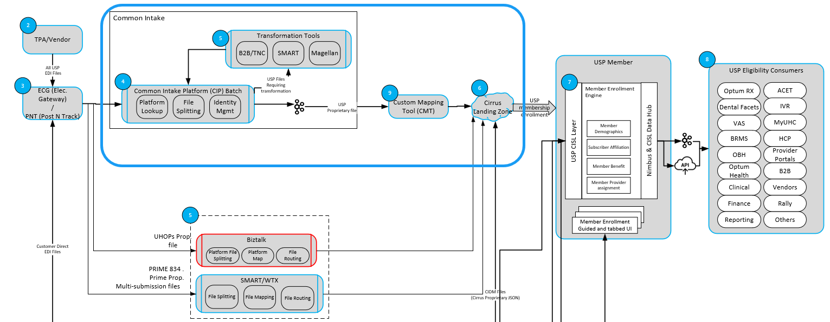
EDI intake & Transformation - C262925
FlexWork new business will leverage existing EDI intake via CIP (Common Intake Platform).
New business customers will adopt one of the CIP-supported file formats for USP.
CIP mappings will be enhanced to support new FlexWork product and Contract Option types.
Files will be transformed via CIP and CMT into Cirrus-native format (CIDM JSON) for enrollment processing.
CMT will require similar updates to support new FlexWork product and Contract Option types

Slide 152
EDI intake & Transformation - C262925
Impact item / Requirement | Approach / Dependencies
Common intake platform (CIP) map updates | Update CIP map to support new contract option types for FlexWork products on USP – EHIPP+NET, EHIPP/HIPP, Critical Illness & Accident protection. Flexwork Medical, standalone Dental, Vision and Financial protection (Life STD) will follow the existing contract Opt Types already supported on USP (no impact) Customers that have slice business on UNET and FlexWork on USP may elect combined layout which could pose additional mapping effort during customer EDI onboarding
Custom Mapping Tool | Update CMT to support new contract option types to support FlexWork products on USP – EHIPP+NET, EHIPP/HIPP, Critical Illness & Accident protection. Config & Test only impact
USP EDI & Xtool format updates | Operation impact Update to USP EDI & Xtool layout and guide to support new codes for contract Opt Types. No schema/field changes Any system enhancement will be covered under the core enrollment engine updates (C247977)

Slide 153
Flexwork
Member Fulfillment Solutioning
C255319 - FlexWork: Member Fulfillment

Slide 154
Work in scope based on business requirements to date

Slide 155
Overview
FlexWork Summary Slide.pptx
Definitions
  ASA: Administrative Services Agreement
  ASL: Aggregated Stop Loss
  BAA: Business Association Agreement
  Bridge Plan – member has both medical and indemnity coverages
  COC: Certificate of Coverage
  DPA: Data Privacy Agreement
  EHIPP: Enhanced Hospital Indemnity Protection Plan
  ISL: Integrated Stop Loss
  MEC: Minimum Essential Coverage
  MVP: Minimum Value Plan
  NODA: Notification of Document Availability
  OAP – Portal supporting Flexwork member self service needs
  SPD: Summary Plan Descriptions
  SBC: Summary of Benefit and Coverage

Slide 156
Background
ST21486 – BUILD FLEXWORK PRODUCTS ON USP AND MIGRATE Flexwork groups/member from UHOPS to USP
Flexwork Customer Fulfillment (C247974)
Member Fulfillment (C255319) – ID Card specific
Link to customizations - FLEXWORK GROUPS - Document modifications.xlsx
Flexwork Products.vsdx
ST21486 Flexwork Product on USP Outcome Solution Intent.pptx

Slide 157
Member Fulfillment
As a FlexWork Platform, I need fulfillment materials distributed including ID cards, fliers, and Notification of Document Availability, based on group approval, product configuration, branding, and enrollment status so that members receive compliant, and non‑duplicative materials because fulfillment artifacts directly impact member understanding, regulatory compliance, and operational rework.

Slide 158
Solution
Impacts
Impacted Team | Impact | Comments
OBM/Plan Library | Capture Group settings for Exclusions (document suppressions for Member NODA) Capture Customization (logo info)
Cirrus Member Group | Honor Hold Logic – release ID on Hold removal Consolidate ID Triggers Support ability to trigger stand alone EHIPP ID cards | First instance of USP generating ID cards that are not Medical
Cirrus Member | Triggering of ID cards for EHIPP + Net standalone (includes bridge plan consolidation requirements)
Fulfillment | Logic to determine if a Bridge card or EHIPP standalone card is to be generated (consider Sub Contract Option Indicator on the MG contract option table to identify) New ID Card template for EHIPP+Net standalone Retrieve additional fields per template New payload fields Ability to consume requests through the Fulfillment Gateway Service from OAP
COM360 | New Subtenant/workflow Receive updated payloads resulting in NODA triggers back to USP Fulfillment New and modified templates
DOC360 | No impacts for Member Fulfillment processing
Trident | Conditional logic to determine what to include w/ Card (ie, Flyers) (Marketing impact) New template needed for EHIPP ID card Work to align custom logos
Marketing | Design of Flexwork flier to be sent with the ID card
Quadient | Flier generation
United Healthcare Communication Services (UCS) | E-delivery – needs to know whether or not the member accesses documents via OAP or myUHC
Shutterfly | New Custom NODA New Fliers (if needed)
Portal | OAP does not currently have a connection to the Fulfillment Gateway Service
UCS
Quadient – letter comp
Marketing – flier design

Slide 159
Member Fulfillment Requirements
Functional Requirements
ID Cards:
Ensure ID cards for new, renewing and migrating business are held from distribution until approval or defined release criteria are met, including support for sample ID cards for customer review. (MEM‑003, MEM-004)
  Standard T-15 ID card hold will apply for migrating customers
  Applies to both the Level Funded Medical and Indemnity plan only ID cards
Ability to request and prepare sample ID cards for migrating customers.
  Applies to both the Level Funded Medical and Indemnity plan only ID cards
Support group‑specific branding by associating a unique customer logo with medical ID cards. (CUST-030, MEM-005, MEM‑006)
Ability to generate and distribute supplemental fulfillment materials (e.g., Flier) as part of the medical ID card mailing. (MEM‑007)
  Initial Mailing
  For subsequent mailing's FlexWork will follow USP standard processes.
Ability to support EHIPP +NET standalone ID card and flier variations. (MEM‑008)
Enable a unified Bridge plan ID card (MEM‑010) to prevent duplication; FlexWork ID cards must adhere to medical mandates. (MEM‑010)
Ability to distribute FlexWork ID cards in alignment with existing USP processes.
Ability to notify EHIPP standalone membership of e-only ID cards if applicable
Ability to display the appropriate web address on the back of the ID card based on whether or not the member is a Flexwork member
Ability to accept ID card requests initiated through OAP
NODA:
Ensure member notification (NODA) is sent for document availability: (MEM‑011)
  SPD - Level Funded
  SBC - Level Funded
  COC - Fully Insured
Ensure Shutterfly is able to distinguish between a USP standard NODA or a custom NODA

Slide 160
Member Fulfillment Requirements (cont’d)
Non-Functional Requirements
Fulfillment variations (logos, fliers, card types) are configurable: (MEM‑006, MEM‑007, MEM‑008)
  Logos - at the customer level
  Fliers - at the customer and product level
  Card Types - at the customer and product level
  NODA - at the customer level
    Lowe's has a customized NODA

Slide 161
How USP Fulfillment will identify a Flexworks member
Flex Indemnity
When Base NetworkID = FLEXWORK_CHOICE
AND Plan Type = Indemnity
Flex Medical
When Base NetworkID = FLEXWORK_CHOICE
AND Plan Type <> Indemnity

Slide 162
Solution – ID Card
Member Group
Trigger based on Hold release
Consolidate Triggers for ID cards when EHIP plus Net offered alongside medical
Member
Triggering of ID cards for EHIPP + Net standalone (includes bridge plan consolidation requirements)
Fulfillment
Receive new or updated action events to trigger ID card issuance (e.g., at renewal) – honoring holds (for manually requested cards)
New templates for Flex
Sending customer logo info on payload
Additional data and logic required to support the decisioning prior to vendor handoff
Trident
Conditional logic to determine which accompanying material is sent, based on member-specific behaviors rather than a static selection
  Working directly w/ Marketing team on what to include and when to include it
Potential template updates (or new templates) to support new wording, data elements, or logo handling

Slide 163
Solution – ID Card (continued)
ID card specific requirement
Bridge plans should produce single card
EHIPP + Net standalone ID cards needed
  Cost shares do not apply, USP Fulfillment should not attempt to retrieve or print
Logic for web address on the back of the card will be modified to incorporate appropriate identification of a Flexwork member
Portal
OAP to build connection to Fulfillment Gateway Service for submitting maintenance card requests to USP

Slide 164
Solution – NODA
COM360
No additional effort – continue to send archive status when “final” document is stored successfully in COM360
Fulfillment
Ability to recognize when NODA suppression is required (Group level attribute)
Trigger NODA letters based upon Archive Confirmed status received back from Doc360 (current state)
Send to Shutterfly to produce and deliver
  Payload content to allow Shutterfly to differentiate between standard and custom
Shutterfly
Create NODA letters and deliver
(potential for new templates)

Slide 165
Solution – Letters
No requirements received to date for new or modified letters in support of Flexworks. All existing member letters coming out of USP will continue to generate as they do today for Flexworks members

Slide 166
Assumption
Current ID Card hold logic will prevent distribution of ID cards until approved assuming hold is properly set.
Group logos exist – one logo per group
Card mailings exist in Trident and controlled thru marketing
  Would need Trident to tell us if additional info is needed to customize which flyer to insert
Member notifications existing today
Plan docs – NODA
ID Cards – if paperless delivery option selected by subscriber
Letters – if paperless delivery option selected by subscriber

Slide 167
Other Questions/Concerns
Do we need to consider for day 1 logic to support EHIPP being sold outside of Flexwork? All indications to date are no.
Question – is Flexwork to be identified using Product Name (per Whitney email) or use of the benefit attribute table?

Slide 168
User Acceptance – Member Fulfillment
1.Scenario: ID Card Distribution Hold for New Business
(FR1)
Given a new business group is onboarded and pending activation
When Member enrollment is complete
Then ID cards are not triggered until the hold is removed or defined release criteria are met
2. Scenario: Group‑Specific Branding and Product Variations on Fulfillment Materials
(FR2, FR4)
Given a group has an approved customer logo
When ID cards are generated
Then the group‑specific logo is applied to the ID cards
3. Scenario: ID Card and Fulfillment Materials Distribution
(FR3)
Given an initial ID card issuance is generated for a member
When the ID card is prepared for distribution
Then supplemental fulfillment materials, such as fliers, are included with the mailing
Scenario: Consolidated ID Card Issuance for Bridge Plans
(FR5)
Given a member is enrolled in a bridge plan (MEC and EHIPP +NET)
When ID cards are generated
Then a single ID card is produced representing the combined coverage
5. Scenario: Customer Notification of Fulfillment Material Availability
(FR6)
Given a member enrolls
When the plan materials are available for distribution or access
Then a notification is issued to inform the customer of the availability of the fulfillment materials
6.Scenario: ID Card request is made from OAP
Given an ID card is requested through the OAP portal
When OAP request successfully reaches the Fulfillment Gateway Service
Then The appropriate ID card will generate after checking for any existing holds

Slide 169
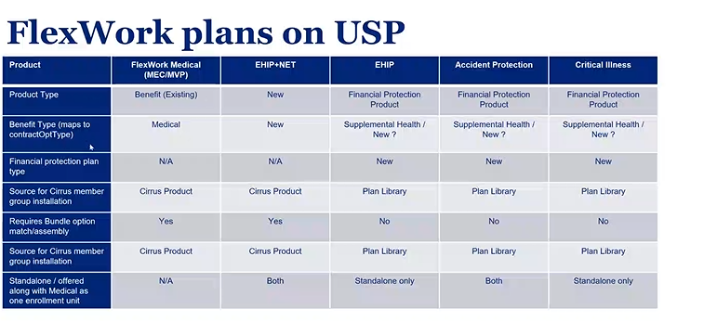

Slide 170
Plans/Revenue Arrangement
Plan | REV Arrangement | Benefit Type
EHIPP +NET | FI | (New)
EHIPP +NET (OON only) | FI | (New)
MEC Basic | LF | Medical
MEC STD | LF | Medical
MVP | LF | Medical
MEC Basic Bridge | LF | Medical
MEC STD Bridge | LF | Medical

Slide 171
Examples of ID cards
Please note: The following examples of ID Cards in this deck reflect the current Flexwork card, this deck will be updated with USP version once the last remaining changes have been confirmed and reflected in the ID card images

Slide 172
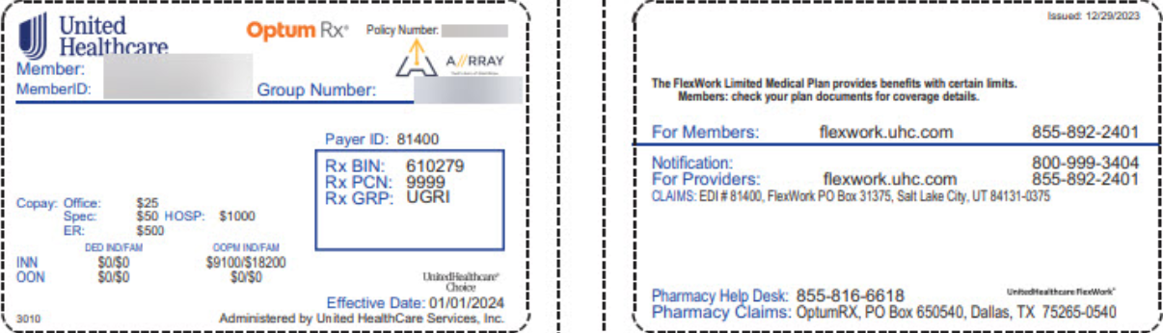
Sample ID Card
Note – effective date in the lower right hand corner of the front of the card will not be on the card
https://uhgazure.sharepoint.com/teams/UHOPSMigration/Lists/FlexWork%20Business%20Needs/Attachments/204/ID%20Example.jpg?web=1

Slide 173

EHIPP Card
Note – effective date in the lower right hand corner of the front of the card will not be on the card
https://uhgazure.sharepoint.com/teams/UHOPSMigration/Lists/FlexWork%20Business%20Needs/Attachments/211/EHIPP%20%2BNET%20Stand%20Alone%20ID%20Card.png?web=1

Slide 174
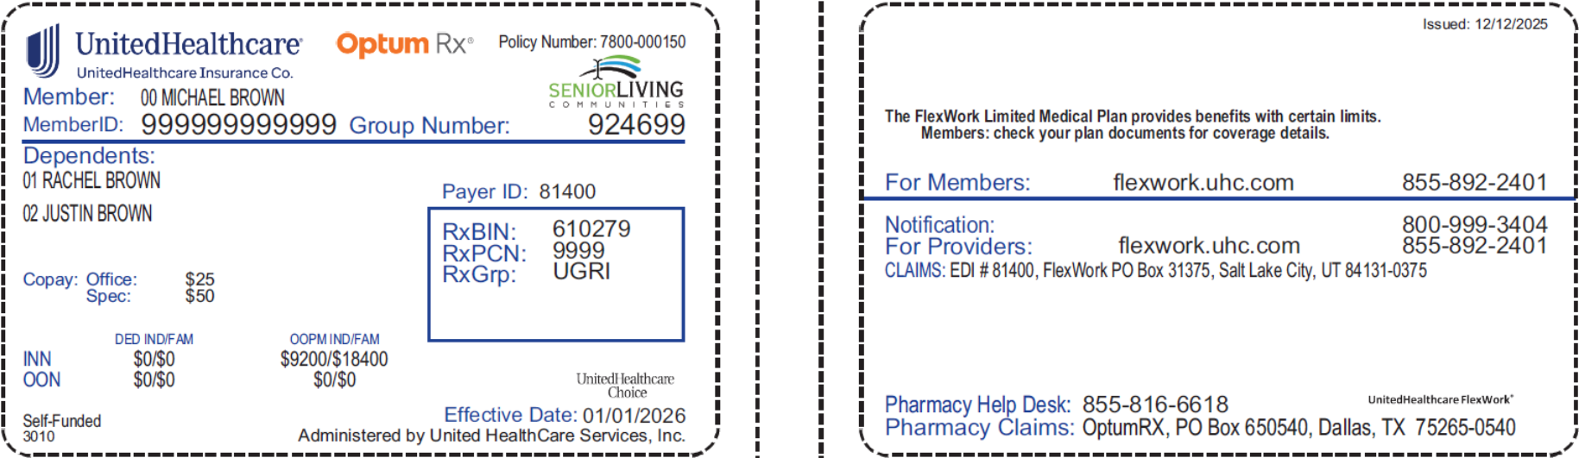
LF Medical Card
Note – effective date in the lower right hand corner of the front of the card will be removed
ID cards from USP are individual cards, not family cards as displayed above
https://uhgazure.sharepoint.com/teams/UHOPSMigration/Lists/FlexWork%20Business%20Needs/Attachments/211/image.png?web=1

Slide 175
Appendix

Slide 176
Non-Association customers and AHPs- One Group versus 2 Group Functionality Comparison
Functionality | One Group per Customer | Two or More Groups per Customer
Customer implementation |  | Sales and implementation tools (Solaris, MERIT, OBM) does not support parent-child setup. Requires changes or manual intervention to complete case installation
Member Enrollment Offerings | Pro- Member enrollment offerings represented under a single group, which makes enrollment process simplified for member and customer | Con- Customer must merge offerings across groups to present as one set of offerings to a member, but keep information separate behind scenes to support renewal data to Cirrus( diff group, diff member id)
ID Card​ | Pro-Member id and group ID shown on ID card remains consistent each year and when mid-year plan changes occur. | Con- Member id and group ID shown on ID card will change each year and when mid-year plan changes occur if chosen plan is on different group within same company.
Member Enrollment and Renewal Feeds | Pro- Simplified enrollment feed process for Customer as member id same and group id same regardless of plan selected by member. Pro- When member switches to a different plan, handled as new plan, not member termination, so member remains whole in Cirrus, and no subsequent processes are impacted. | Con- Different member id must be sent (external facing) used each time member switches to plan that exists on a different group. Con- Member needs to be sent as a termination on one group and added to another group, then potentially reinstated on the other group if the switch plans again. Con- Need to be able to identity difference between a true termination and a group switch for fulfillment and other functions.
Billing Flexibility | Pro- Systematic functionality exists to consolidate or split billing as needed across many attributes including carrier and product type. | Consolidation across groups will require custom manual development setup process
Reporting Flexibility | Pro- Existing DRA data in key data solutions such as Nimbus, HCP, UDW, Status, CRM have all data needed to support consolidated or split reporting as needed. including carrier and product type. | Con- Existing reporting data would need to be enhanced to provide a way to cross-reference the multiple groups within a single customer.
B&E Portal Presentment | Pro- Customer and Broker can view all information for the customer under a single group login. This includes billing, enrollment, member history, commissions, summary reports, etc. Pro-Can enroll subscribers and dependents within the group | Con- Customer and Broker must login to different groups separately to view all information for the customer. This includes billing, enrollment, member history, commissions, summary reports, etc. Con- Some reports and billing may need consolidated to allow a single document view within a login. Con- Cannot enroll subscribers and dependents across multiple groups
B&E portal Security | Con- Custom config and potentially development required to restrict access to some information but not other for certain users. | Pro- Easier to implement restricted access across groups.
Accumulators | Pro-Member’s Annual Deductible and OOP accumulators remain whole regardless of a mid-year plan change within the same company. Pro- Member’s Lifetime maxes are kept intact year over year | Con- Member’s Annual Deductible and OOP accumulators reset when mid-year plan change is made by member. This can violate EHB regulations. Con- Member’s lifetime maxes are reset when member changes plans that exist on a different group for the same company.
Authorizations and Referrals | Pro- An existing authorization or referral can be used for a member even when they switch plans. | Con- Authorizations and referrals are not shared across groups. Provider must resubmit or a manual process must copy the auth or referral.
Member Portals | Pro- Vision portal will display all plans the member has for the customer. (check with Michael Pham) | Con- Vision portal will display only plans associated to the group in focus( Check with Michael Pham)
Customer Service Portals | Pro- ACET customer service can access all plan info for a group with login | Con- ACET customer service logs in with a group in focus for customers and will need to know there is another group id that will contain additional info about the customer and login with that group id also to see full customer offerings.
Provider Portals | Pro- Single group login required. UHC Provider Portal will show all info for all plans for a customer when logged in to single group. | Con- Login for each group needed. Provider may not realize there are multiple groups for the same customer and only look for data in one of the groups.
Finance: | Pro-Finances can be consolidated within a group or split out by attributes | Finance will need to be updated manually to consolidate banking and other finance functions

Slide 177
Enrollment/insuring rules
Waiting period – Customer defined. (Standard: First of the month after 30/60/90 or Date of Event)
  USP Current state: Cirrus does not allow waiting period to go beyond 90 days for both Medical & ancillary.
  Confirmed by FlexWork business that all customer own their WP calculation. The waiting period information is not presented on the SPD. The customer calculates the waiting period and reports the coverage effective date. Cirrus must use the requested effective date reported by the TPA/customer on the file. Testing to confirm the coverage is not offered as of the Date of hire date since the coverage effective date on file will be different than the DOH
  DOH is required for EDI enrollment on cirrus even if the WP calculation is owned by the customer – Any support for non ACA waiting period is tagged to Surest ASO. FlexWork will reuse the functionality surest ASO will implement.
  For FPP (Life, ADD, STD/LTD etc) non-contributory plans there are specific rules that affect the coverage effective date based on the QE type – Follow the USP standard for these FPP plans
    Flexwork customers are sold only STD, Life (no ADD)
Termination Date – Supplied by customer. Will be supported using “date of event” rule type in cirrus – No impact
Retro add, term or change
  USP Current state: All LF Medical gets a standard 31 days applied via Enrollment Rules Schedule
  LF FlexWork uses 60 days as standard and must have ability to set this standard as part of customer implementation and install. On exception bases a member could be allowed to go beyond 60 days at member level on a case by case basis. Ability to override retro rules is part of Surest ASO effort. FlexWork will reuse the functionality surest ASO will implement
  FlexWork customer could potentially have different retro rules for Standard LF medical and FlexWork medical under the same customer
Notification rule
  For LF medical, both Retro and notification are managed within enrollment rule schedule. For FlexWork customer no notification rule will be applied. Customer/vendor does not report QE type and date on file. – IT impact for member group and member
Max Age
  LF FlexWork Max Age is 26 –
  Ancillary Follows medical, unless state mandates specifically require ancillary to follow a different mandate (e.g., Florida is age 30 for fully insured medical. FlexWork medical follows max age 26. In this case, ancillary would follow the medical max age of 26, unless state mandates specifically require something different for ancillary products.) - Dev impact to cirrus member group to allow max age on the CO insuring rule to be lower than the guardrail
  Max age process for FPP follows the medical, there is a separate AHA to enhance this – Deena to provide the AHA information. Operation impact on OBM to capture and send the appropriate Max age when ancillary has different rules than Medical. Max age utility current state is not supported for FPP members
  Eligibility service area validation:
  For medical benefits subscribers in Hawaii are excluded from coverage.
  EHIPP plan groups with situs in New Mexico are not eligible, however members living in New Mexico are eligible as long as the group situs is outside of New Mexico and the group size is less than 100.
  USP current state: Eligibility service area validation is excluded for migrating members from UHOPS. This exclusion for the life of the member under that member group (subsAffiliation). Confirm if UHOPS FlexWork members follow the same approach – This impacts all migrated customers across all platform and products not specific to FlexWork – Part of surest but pended for funding

Slide 178
Sales/Underwriting/renewal tools
Group size | Sales | Plan source | Underwriting /Rating | Renewal | Customer implementation/installation
Key Account 100+ | Solaris | LF standard medical – Plan Library Standalone D/V/FPP – Stepwise CQS LF Flexwork MEC/MVP medical – Plan library EHIPP+NET (standalone and embedded) – Plan Library EHIPP/HIPP only – Stepwise CQS Accident protection – Stepwise CQS Critical illness – Stepwise CQS | LF Flexwork MEC/MVP medical – External pricing tool LF standard medical – KART Standalone D/V/FPP – Stepwise CQS EHIP+NET (standalone and embedded) – Stepwise CQS EHIPP/HIPP Standalone – Stepwise CQS Accident protection – Stepwise CQS Critical illness – Stepwise CQS | Renewal – Mini-mart Renewal package – KART Pre sale SBC & Benefit summary – DOC360 | OBM -> Cirrus
National Account 100+ | MERIT | Same as above | Same as above | Same as above | Same as above

Slide 179
Member management
- Fulfillment impacts (will be discussed under fulfillment capability)
- Separate ID card for standalone EHIP+NET with no medical. Consolidated trigger when EHIP+NET is offered along with Medical as a sub
- New FlexWork Flyer (probably not a separate trigger) -

Slide 180
Benefit Plan (Level 1) Group Build & Activation Process
C237551: Business Capabilities: Phased Plan Activation Enablement | Rally
SIPOC | Group Build and Activation Process via Cirrus MG HW and CCV API
Supplier(s) | Customer Implementation Team
Input(s) | IMO/BCM: A fully defined custom fully-insured medical plan (e.g. status = “Final”) IMO: triggers group transition from implementation to installation when the implementation process is complete.
Process(es) | Cirrus Product Core (enhance) BBMA Process – accept and enable both “Install Only” and “Active” to pass (enhance) get latest benefit version component -- accept and enable both “Install Only” and “Active” to pass (used by Magneto and Cirrus 270/271) OBM API triggers Cirrus MG and CCV API when installing the case Cirrus MG HW and CCV API API triggers BBMA Process Enhance API to allow “Install Only” and “Active” status to proceed with group build (Optional) Enhance API to set Claims HOLD ON; Claim adjudication already looks at Plan Status being “Active” to proceed; this would enable operations to see why Claims is placed on HOLD. …
Output(s) | Successful group build and activation into Cirrus Member Group
Consumer(s) | Customer – Fulfillment (Cirrus Fulfillment – Magneto, COM360) Claims Management (Cirrus Claims) Downstream consumers of group activations: Clinical, Behavioral, Specialty Benefits, Incentive, Banking Services, etc.
Notes:
Assumptions:
- SPIs variations will fit into our existing plan benefit configuration patterns. If feature level analysis of SPIs identify exceptions, delivery team will escalate for EA/PA evaluation.

Slide 181
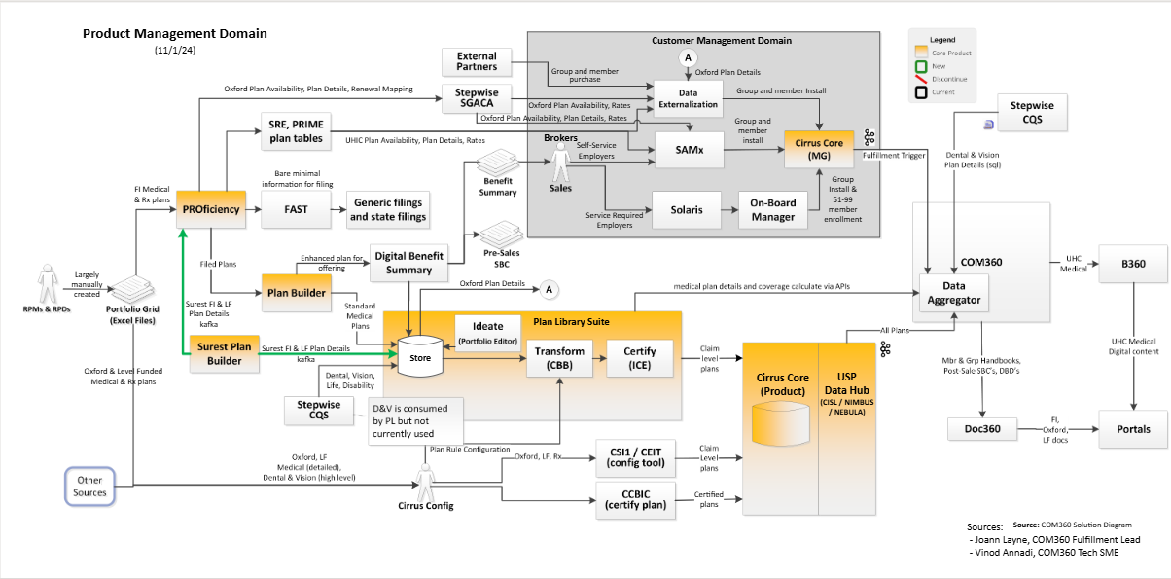
Current State (Product & Benefit perspective)
SoR = system of record (where we manage the data)
SoT = source of truth (common source where the data is aggregated and shared with downstream consumers)
SoR_vs_SoT.pdf (technical)
SoR for UHC FI & LF standard medical plans
SoR for Surest medical plans
SoR for Specialty plans
SoT for medical plans
Source: Product Management Domain.vsdx

Slide 182
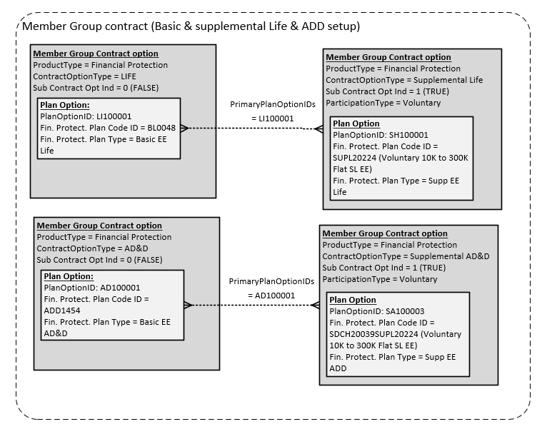
Sub-contract option setup – Current state

Slide 183
Flexwork Member Group structure Options - comparison
Member Group structure - HeatMap/Estimates
 | Option 1 – one member group (Full-Solution) | Option 2 – Two child member group with parent (Full-Solution) | Option 2A – Two standalone member group – Parity only | Option 2B – Two child group with parent – Parity only
Description | Implement full strategic solution with USP member group for life | Minimize impact to Finance stream by managing customer across two member groups. Implement full systematic solution to provide consolidated experience for customer | Follow UHOPS approach of managing customer as two independent member groups. Solve for parity only | Option 2 + solve for parity only
Pros | Align with USP standard model with minimal business process impacts Simplified customer experience Better downstream consistency Minimal system fragmentation with fewer impacted systems compared to option 2 Lower overall incremental cost Vs option 2 | Avoids upfront impact to finance/Claims domains Supports consolidation experience leveraging parent group that acts as link across multiple groups | Follows current UHOPS model Matches existing manual operation model on UHOPS Avoids upfront impact to finance/Claims applications Consolidated Billing (above parity) | Lower cost than option 2, avoids building full automation across systems Keeps parent group that acts as link across multiple groups but limits enhancement for initial phase Consolidated Billing (above parity)
Cons | Heavy impact on Finance & Claims | Deviation from USP standard causing impacts across Sales, implementation, enrollment, portals, reporting. High system and operation complexity High tech deabt and cost due to broad system changes and manual work if not automated | High operational burden No consolidation capability except invoice presentment Degraded customer and member experience compared to USP standards Risk of overpayment due to errors/miss with manual Accumulator pairing Purely “as-is” replication with limited future scalability | Inherit option 2 concerns with high complexity and cost for automation Relies heavily on manual operations Risk of long term inefficiency due to Inconsistent experience when some areas automated and others manual
Impact to AHA Estimate $9,249,128 | Includes ~ $529,000 Pending BRMS confirmation of upfront cost for Finance and Claims. | Increases cost by an additional $621,000 + pending on top of the AHA estimate ($1,544,000 - $529,000) | Reduces upfront cost by $529,000 Parity Enable Toggle capability on Customer service and self-service portal ($88,000) Single consolidate invoice (Existing capability) Ability to accept single payment and apply to multiple customer accounts (Pending BRMS) Above parity Recommendation is to switch to option 1 ($529,000) + Manual transition | Reduces upfront cost by $529,000 Parity Enable Toggle capability on Customer service and self-service portal Single consolidate invoice (44,000) Ability to accept single payment and apply to multiple customer accounts (Pending BRMS) Above parity Recommendation is to switch to option 1 due to cons in option 2

Slide 184
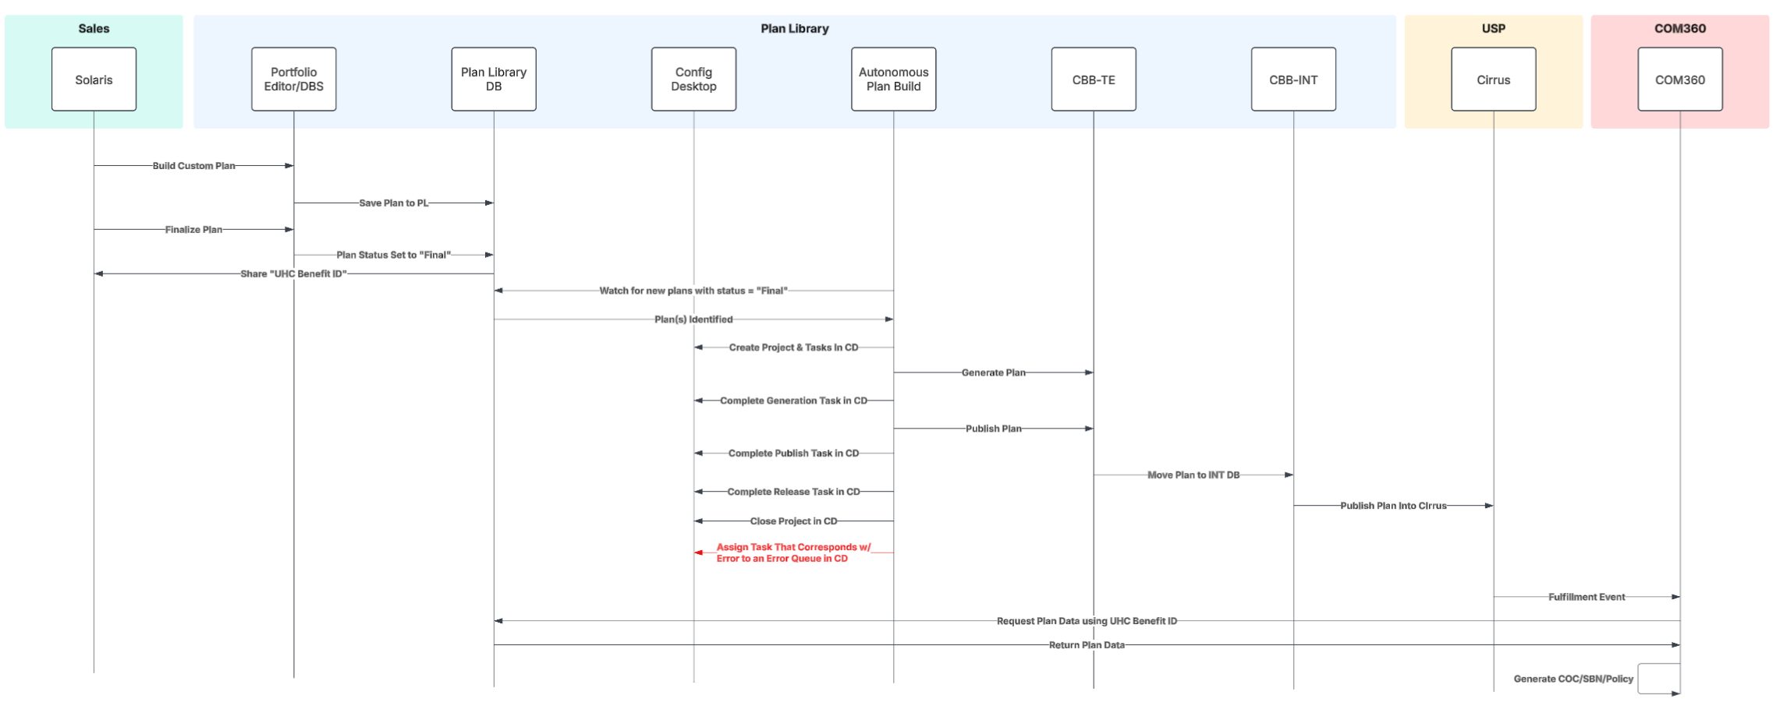
Sequence Diagram Plan Library Perspective
Components reflected for “Install Only” status
C237551: Business Capabilities: Phased Plan Activation Enablement | Rally
NEED UPDATED DIAGRAM FROM CONNOR
A
NRT
B
Plan refresh
Bundle refresh
IMO/BCM manually triggers by setting status to “Final” (meaning everything that can be configured in PE/DBS is complete. Would there be scenarios when a benefit category is not yet complete? (do we need another status)? Post R1
Autonomous Plan Build (APB) scans for newly “Final” plans from PL (nightly?)
APB (CBB) tracks its progress in Config Desktop (CD) as a “Project & Task”.
Benefit Config would be involved if APB results in failed attempts (3x).
When CBB->Cirrus Product Core meets Install Only scenarios: Plan & Bundle status = “Install Only”
Assumption: BBMA will fail if the status for the plan build in Cirrus Product Core is not “Active” or “Install Only”.
C
CBB sets the status: Active,
Install Only
E
(seconds, mins, hours)???
D
Source: Large Group Expansion - Data Flow: Lucidchart
Snapshot from 07/01/25

Slide 185
Sequence Diagram: How plan code and plan name transitions from sold case to implementation (proposed state)
C237551: Business Capabilities: Phased Plan Activation Enablement | Rally
Enhance HW/CCV API to accept “Install Only” as valid plan status besides “Active”
Enable HW/CCV API call after L1 plan build instead of waiting for L2 plan build
Shifting the L2 plan build from before HW/CCV API to after HW/CCI API to enable engagement of downstream post-install processes.
Notes:
Feedback from Lou 09/19:
For item 4, MG currently only considers bundle options in active status as valid for assignment to a plan option. Enhancement would be needed on the MG side to allow assignment for the new install only status.
For item 6, a bundle refresh is initiated by product and cascaded down to MG for all contract options that have a plan configured with a given bundle option.
FYI there are settings on the product side when attributes within the bundle are modified to determine whether a bundle refresh actually needs to be cascaded down to MG. This is intended to prevent unnecessary system processing when changes occur on the product side that are not material to group and member.
I don't believe MG would need to do anything different than we do today in terms of accepting the bundle refresh push from product. We may need to look at the logic on the group side around bundle status to ensure we can support the new status of install only.
As far as the release of the claim HOLD, we might need to better understand the requirements for that. A hold can be applied with an expiration date that will auto expire once met (for example, OPS places an ID card hold which expires 15 days prior to the effective date of coverage - during both install and renewal). If the hold is to be released based upon the completion of certain events, this can be done manually. However, if there is an expectation that we need to incorporate automation for lifting the hold, this would be IT lift. I could be wrong, but I don't think we have event driven automation for this today.

Slide 186
Revision History
Date | Contributor | Description of Changes
03/10/2025 | Riyaz Mohammed | Initial Draft copied from template and updated with preliminary project information.

